Slide 1
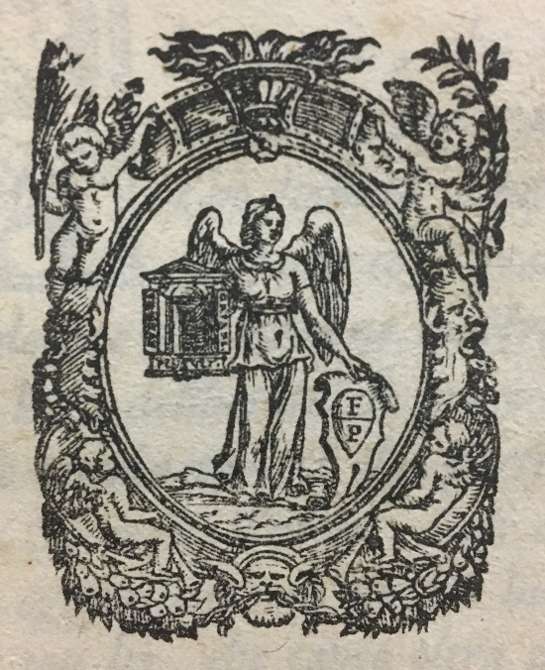

Slide 2
1572

Slide 3
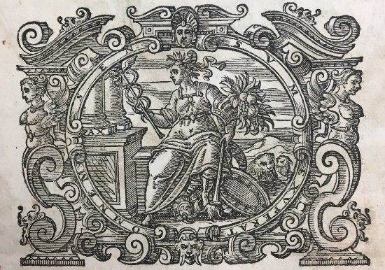

Slide 4
1606

Slide 5
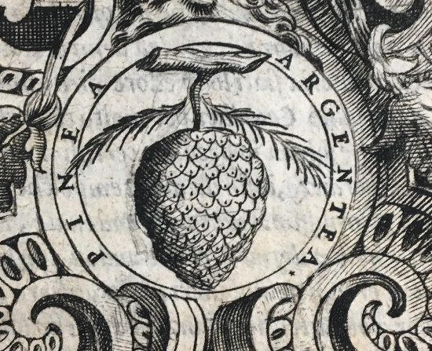

Slide 6
1568

Slide 7
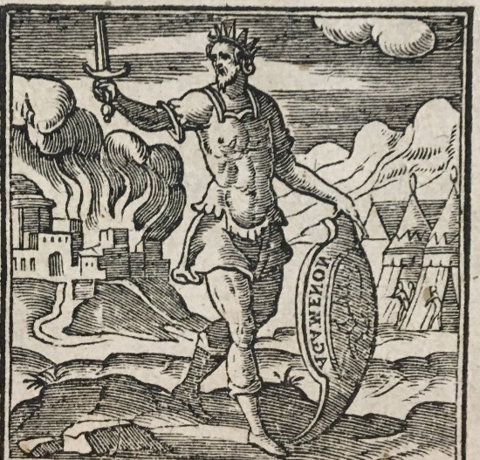

Slide 8
1624

Slide 9
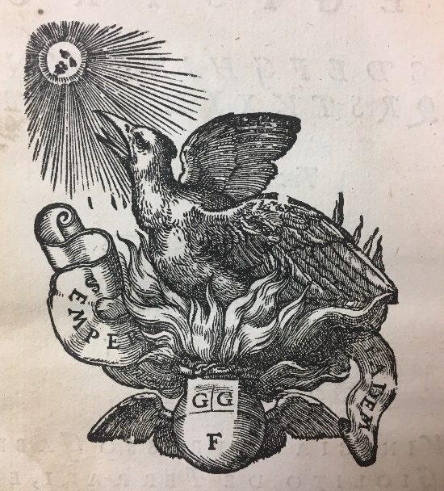

Slide 10
1555

Slide 11
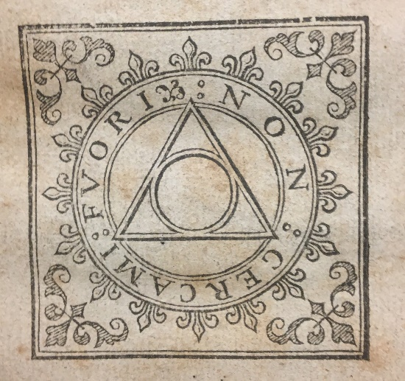

Slide 12
1610

Slide 13
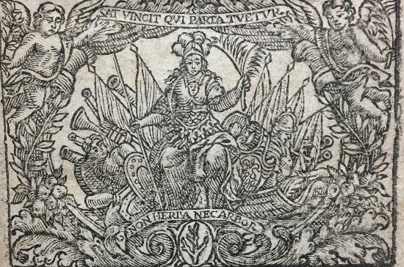

Slide 14
1669

Slide 15
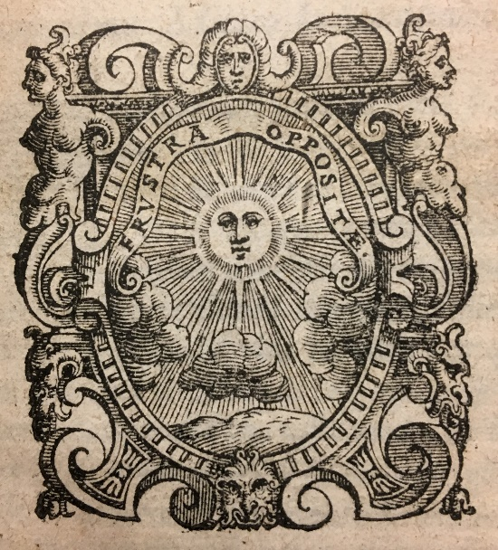

Slide 16
1585

Slide 17
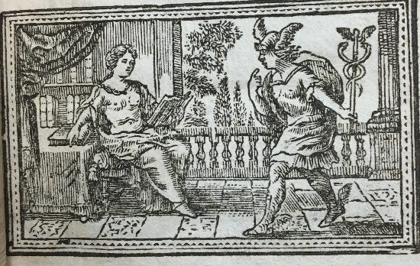

Slide 18
1705

Slide 19
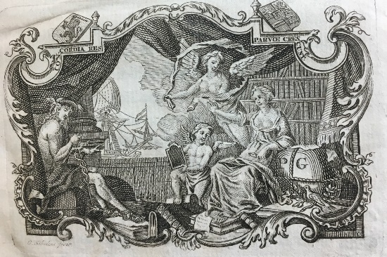

Slide 20
1762

Slide 21
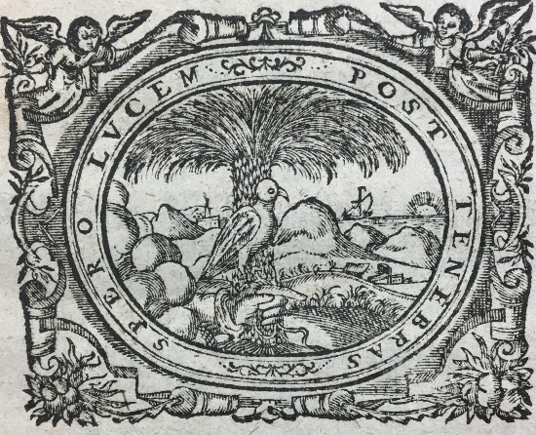

Slide 22
1629

Slide 23
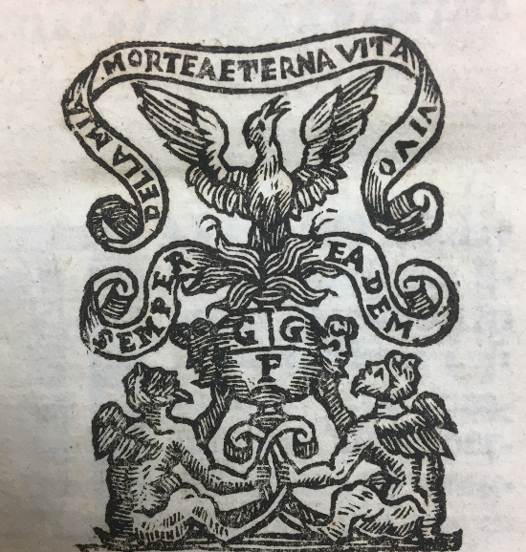

Slide 24
1562

