Slide 1
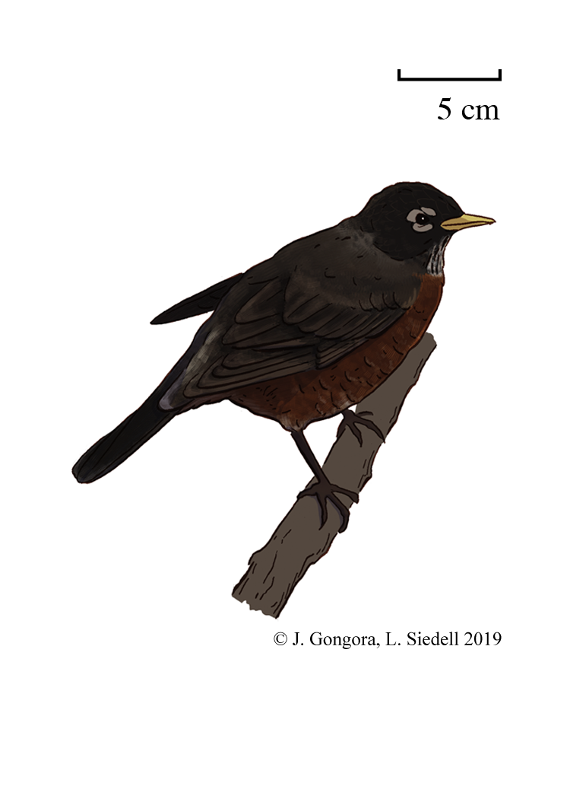

Slide 2
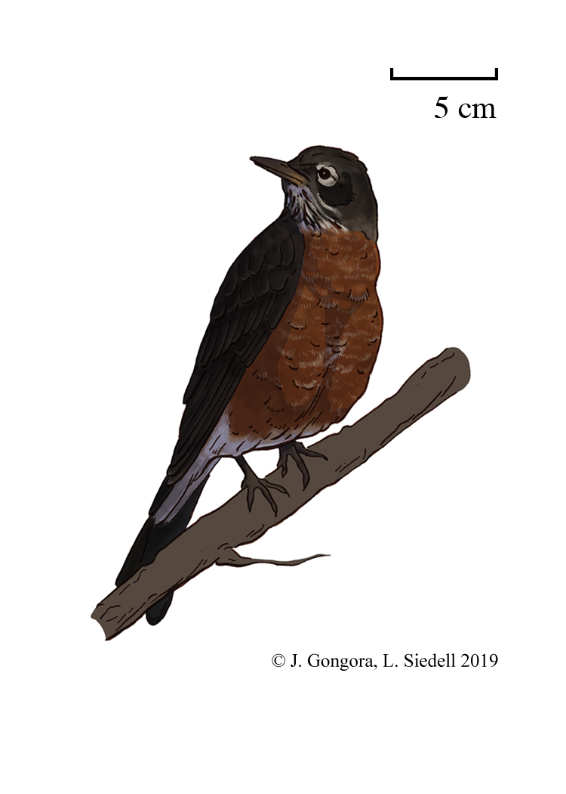

Slide 3
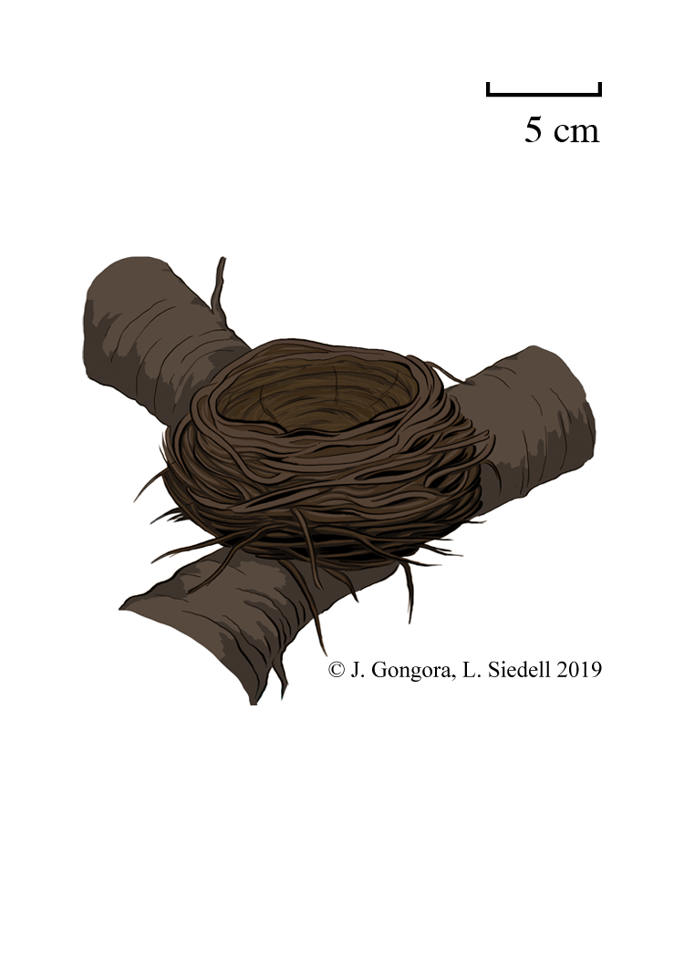

Slide 4
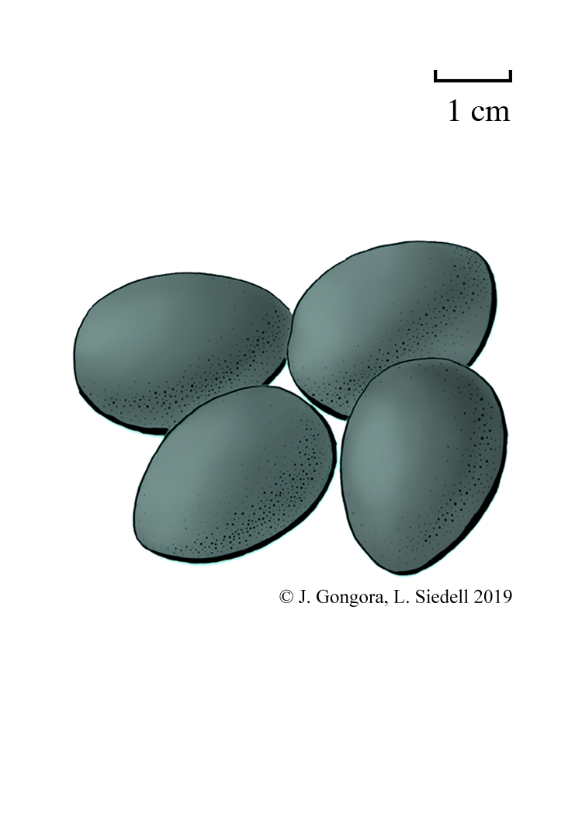

Slide 5
Turdus
migratorius
American
Robin
Female
Fun Fact: Robins are eaten by snakes, hawks, and cats

Slide 6
Turdus
migratorius
American
Robin
Male
Fun Fact: Robins eat earthworms, berries, and insects

Slide 7
Turdus
migratorius
American
Robin
Eggs
Fun Fact: The Robin is one of the first birds to lay eggs in the spring

Slide 8
Turdus
migratorius
American
Robin
Nest
Fun Fact: Robins’ nests are lined with mud, making them heavy and strong

Slide 9
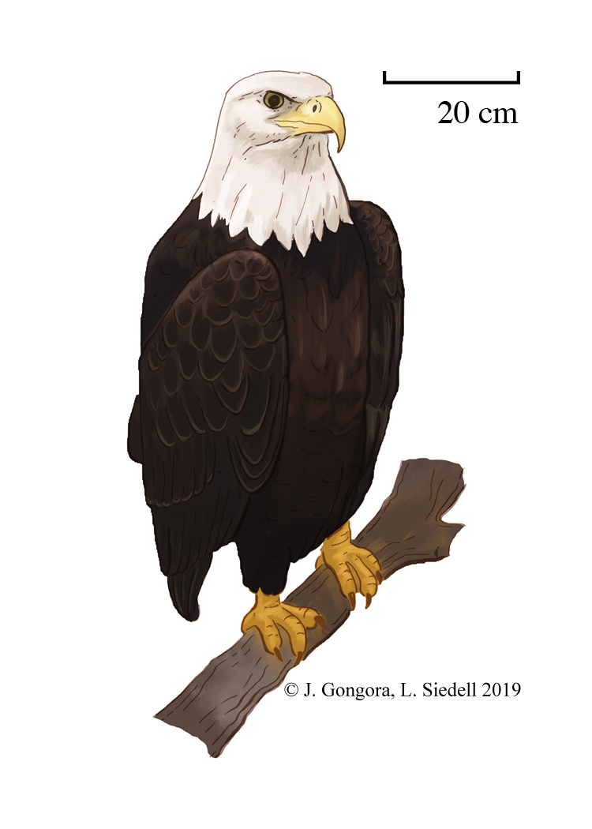

Slide 10
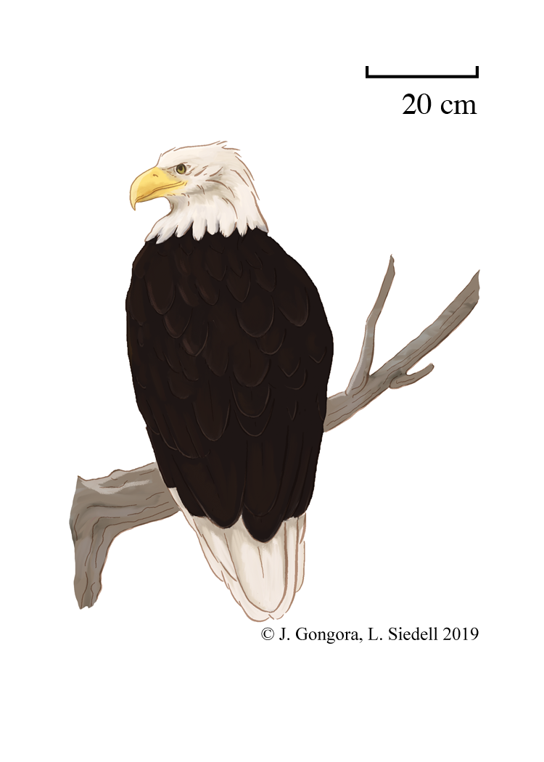

Slide 11
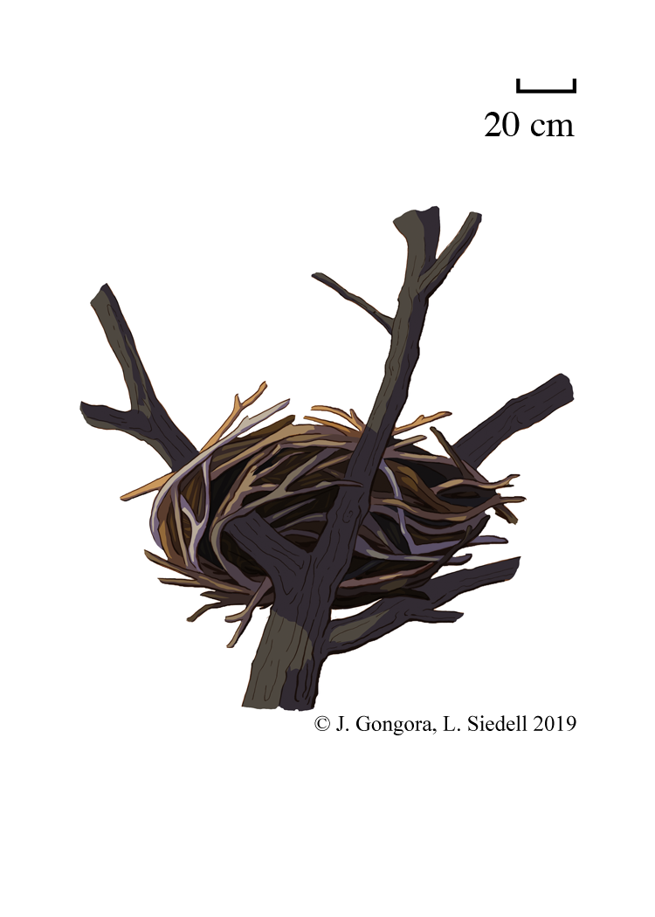

Slide 12
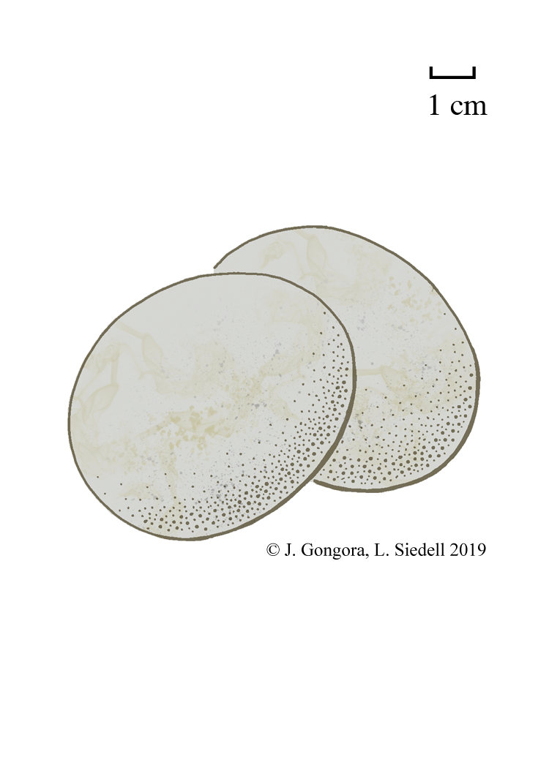

Slide 13
Haliaeetus
leucocephalus
Bald Eagle
Female
Fun Fact: Bald eagles don’t get their white head feathers until they reach adulthood

Slide 14
Haliaeetus
leucocephalus
Bald Eagle
Male
Fun Fact: Bald Eagles are more likely to steal a fish from another bird than catch a fish themselves

Slide 15
Haliaeetus
leucocephalus
Bald Eagle
Eggs
Fun Fact: Pesticides in Bald Eagles’ diets can lead to weak eggshells and lower reproduction

Slide 16
Haliaeetus
leucocephalus
Bald Eagle
Nest
Fun Fact: The largest bird’s nest on record was a 9.5 ft. (2.9 m) wide and 20 ft. (6.1 m) tall Bald Eagle’s nest

Slide 17
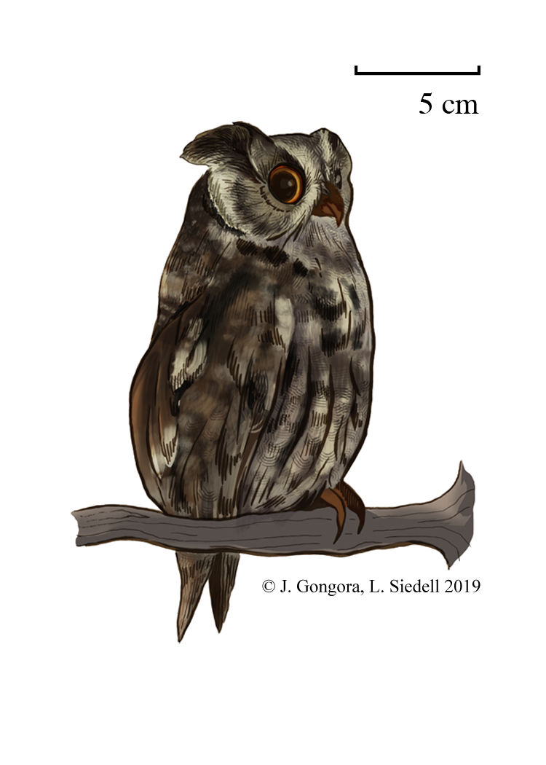

Slide 18
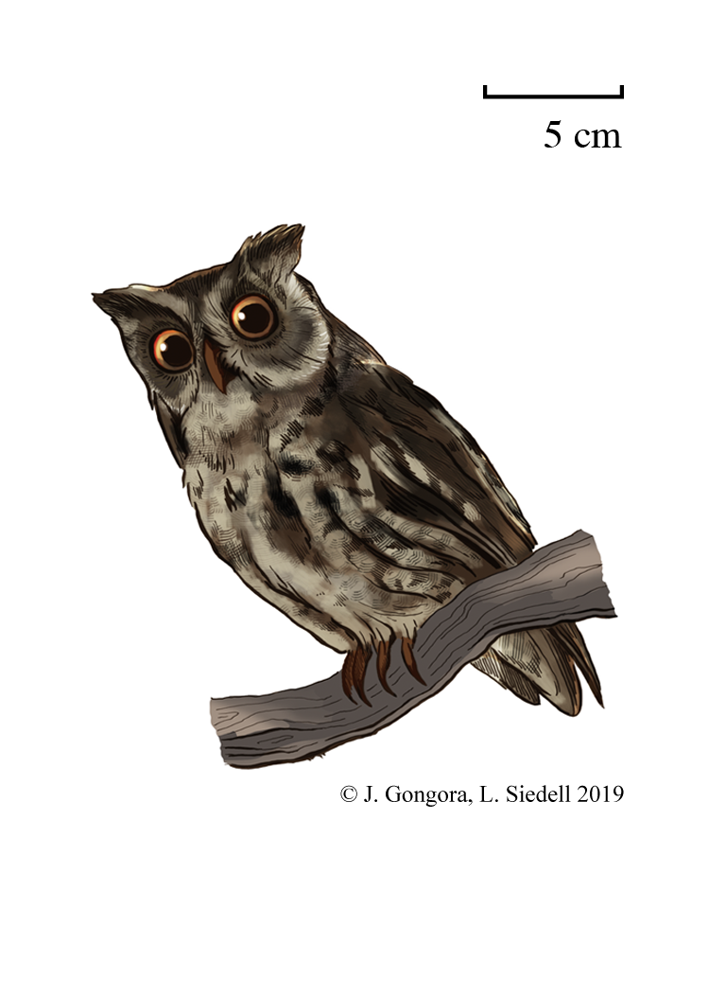

Slide 19
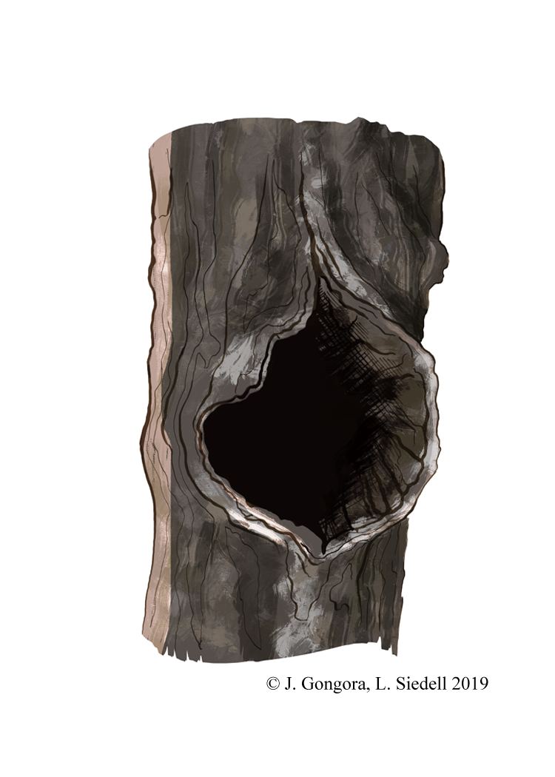

Slide 20
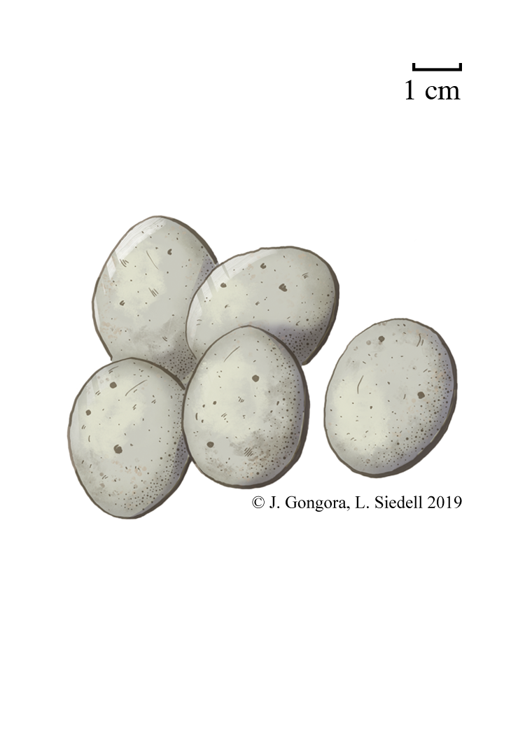

Slide 21
Megascops asio
Eastern
Screech-Owl
Female
Fun Fact: Eastern Screech-Owls usually mate for life

Slide 22
Megascops asio
Eastern
Screech-Owl
Male
Fun Fact: Screech-Owls regurgitate the bones, fur, and feathers of their prey in “pellets” daily

Slide 23
Megascops asio
Eastern
Screech-Owl
Eggs
Fun Fact: Eastern Screech-Owl chicks will fight in the nest, and kill each other if food is scarce enough

Slide 24
Megascops asio
Eastern
Screech-Owl
Nest
Fun Fact: Eastern Screech-Owls will bring living Texas Blind Snakes to their nests, which raise nestling survival

Slide 25
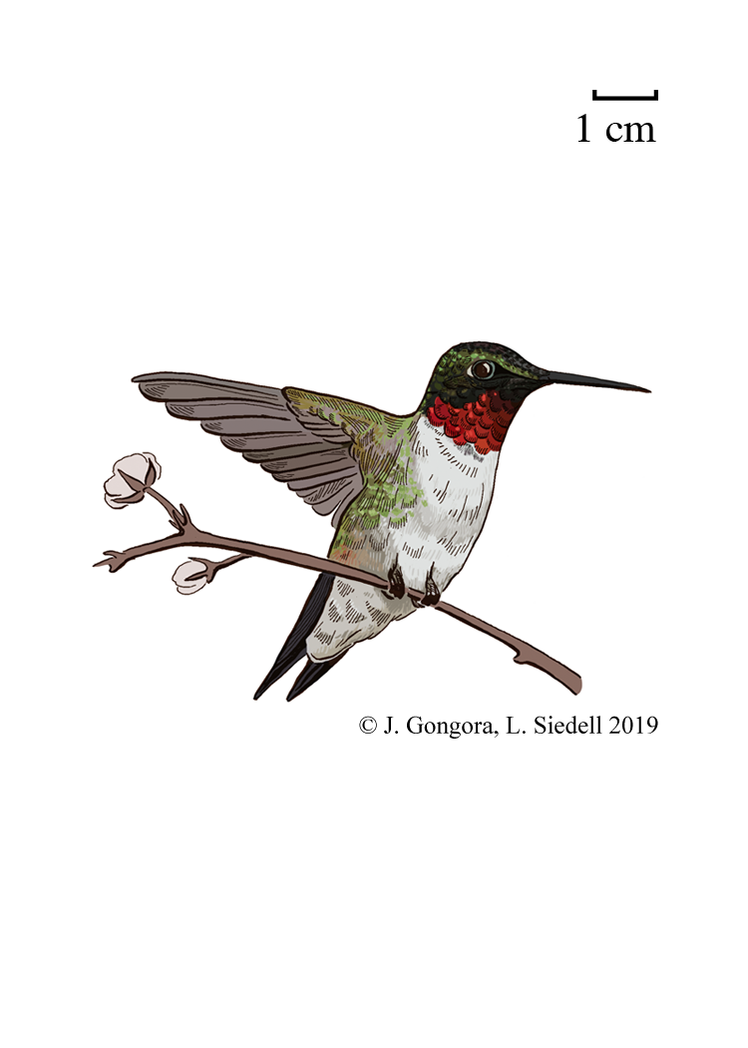

Slide 26
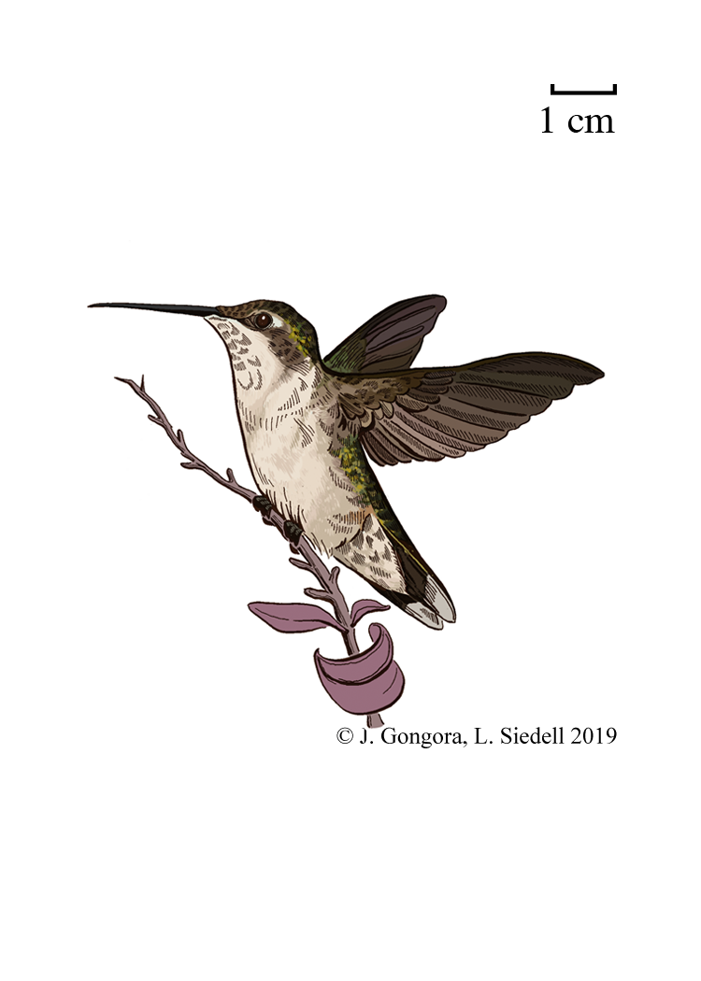

Slide 27
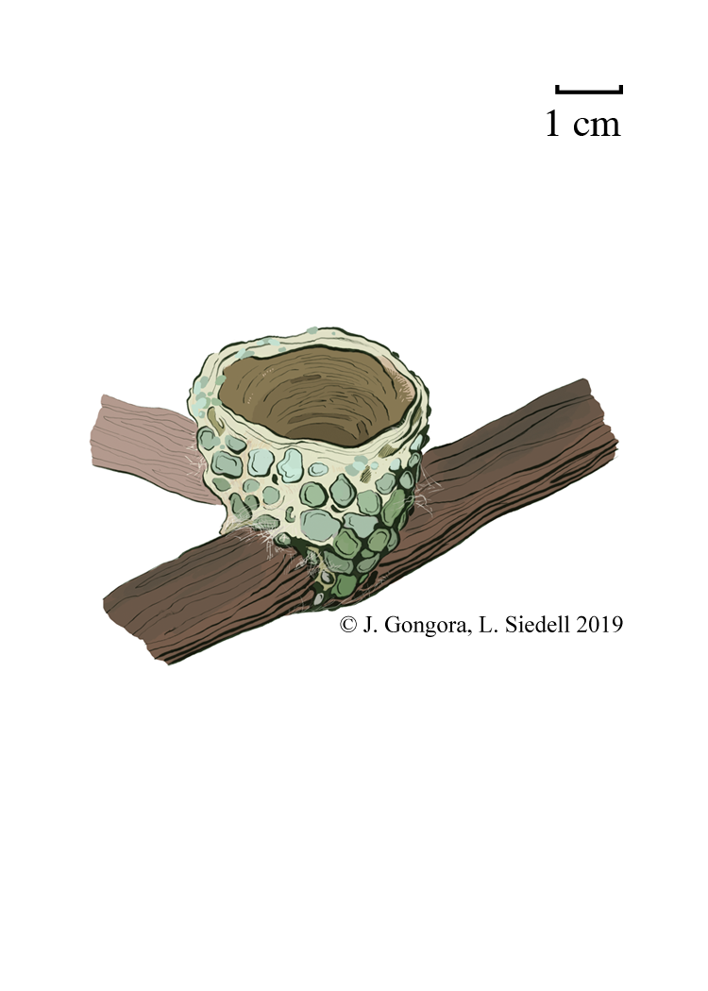

Slide 28
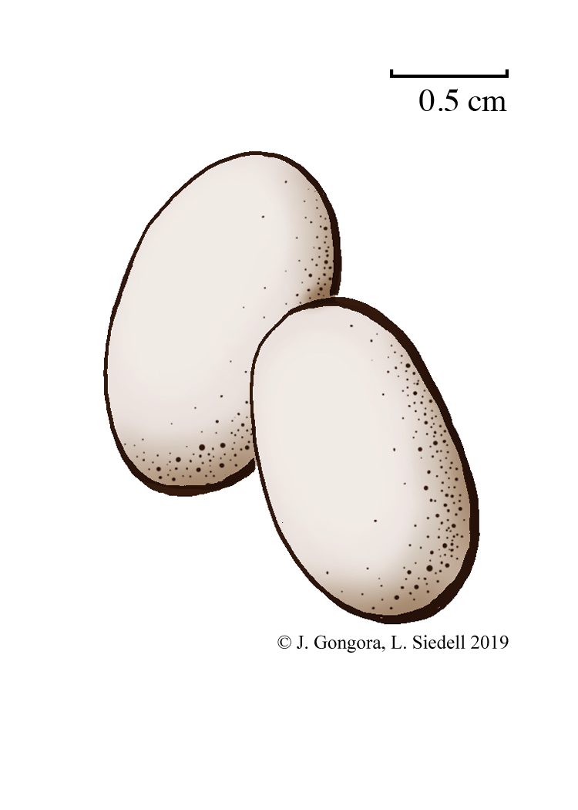

Slide 29
Archilochus
colubris
Ruby-throated Hummingbird
Female
Fun Fact: Ruby-throated Hummingbirds beat their wings over 50 times per second

Slide 30
Archilochus
colubris
Ruby-throated Hummingbird
Male
Fun Fact: Ruby-throated Hummingbirds’ legs are so short they can’t hop or walk

Slide 31
Archilochus
colubris
Ruby-throated Hummingbird
Eggs
Fun Fact: Hummingbirds feed on the nectar from flowers and hummingbird feeders

Slide 32
Archilochus
colubris
Ruby-throated Hummingbird
Nest
Fun Fact: Ruby-throated Hummingbirds attach their nests to branches with spider silk

Slide 33
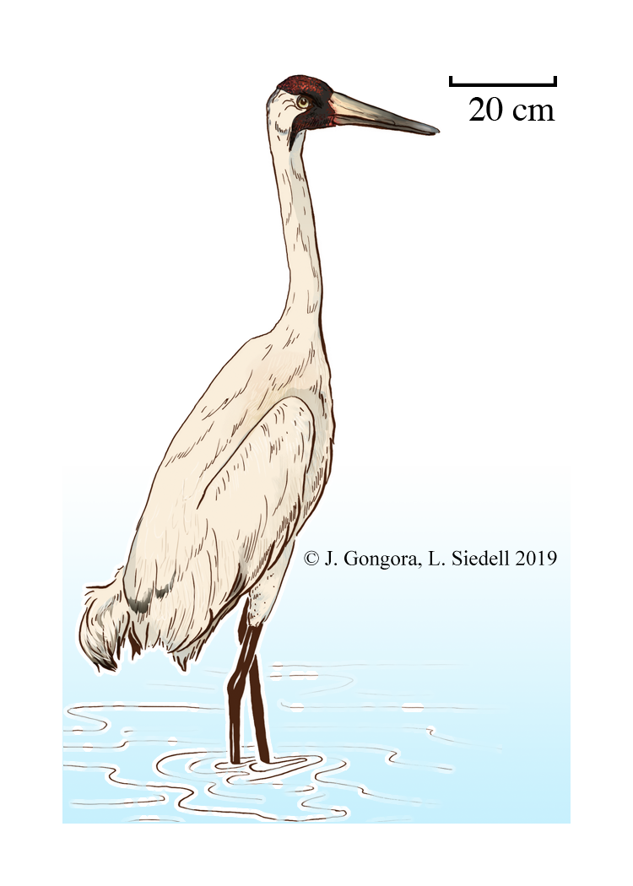

Slide 34
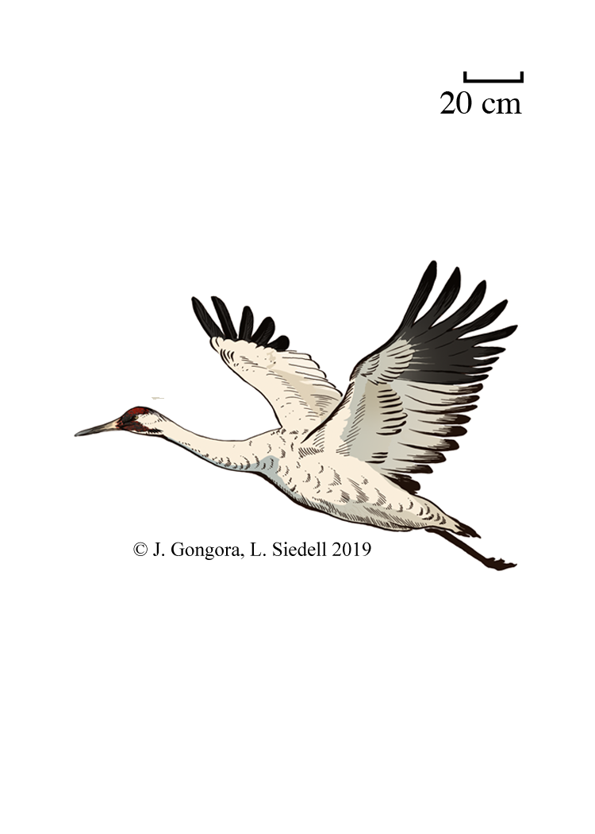

Slide 35
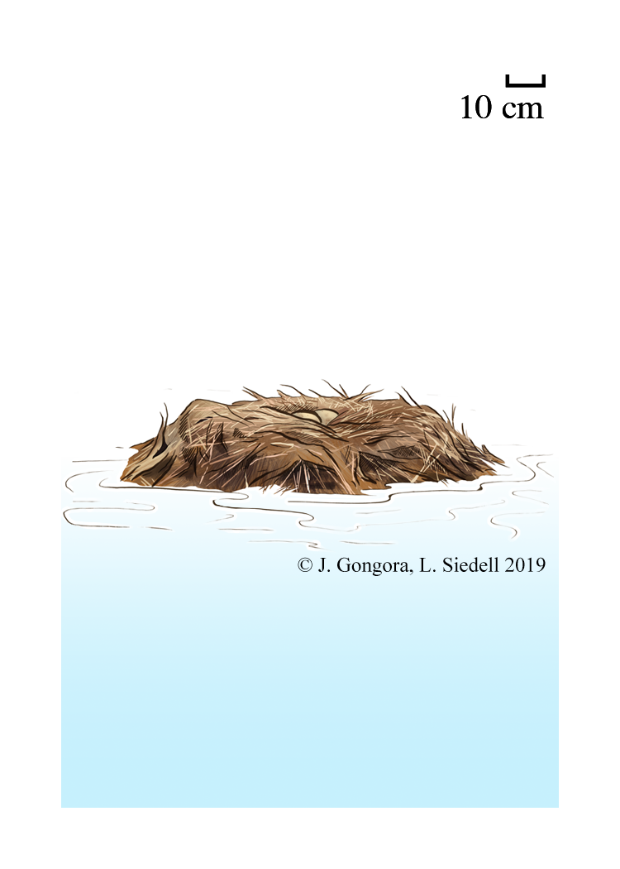

Slide 36
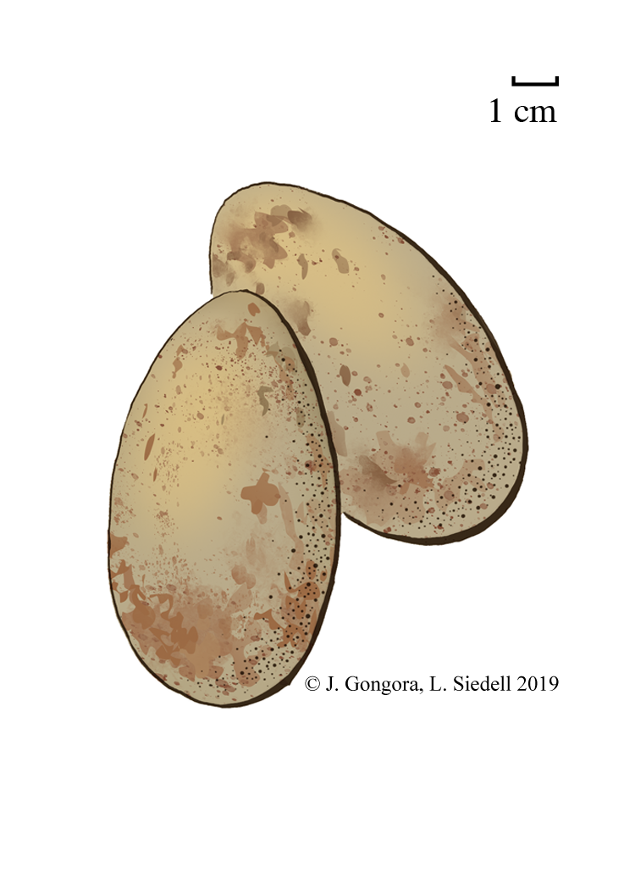

Slide 37
Grus americana
Whooping Crane
Female
Fun Fact: The oldest known wild Whooping Crane was at least 28 years old

Slide 38
Grus americana
Whooping Crane
Male
Fun Fact: Whooping Cranes are the tallest birds in North America, at 5 ft. (1.5 m) tall

Slide 39
Grus americana
Whooping Crane
Eggs
Fun Fact: There were only 21 Whooping Cranes alive in 1941, but now there are over 600

Slide 40
Grus americana
Whooping Crane
Nest
Fun Fact: The water around a Whooping Crane’s nest offers protection and food

Slide 41
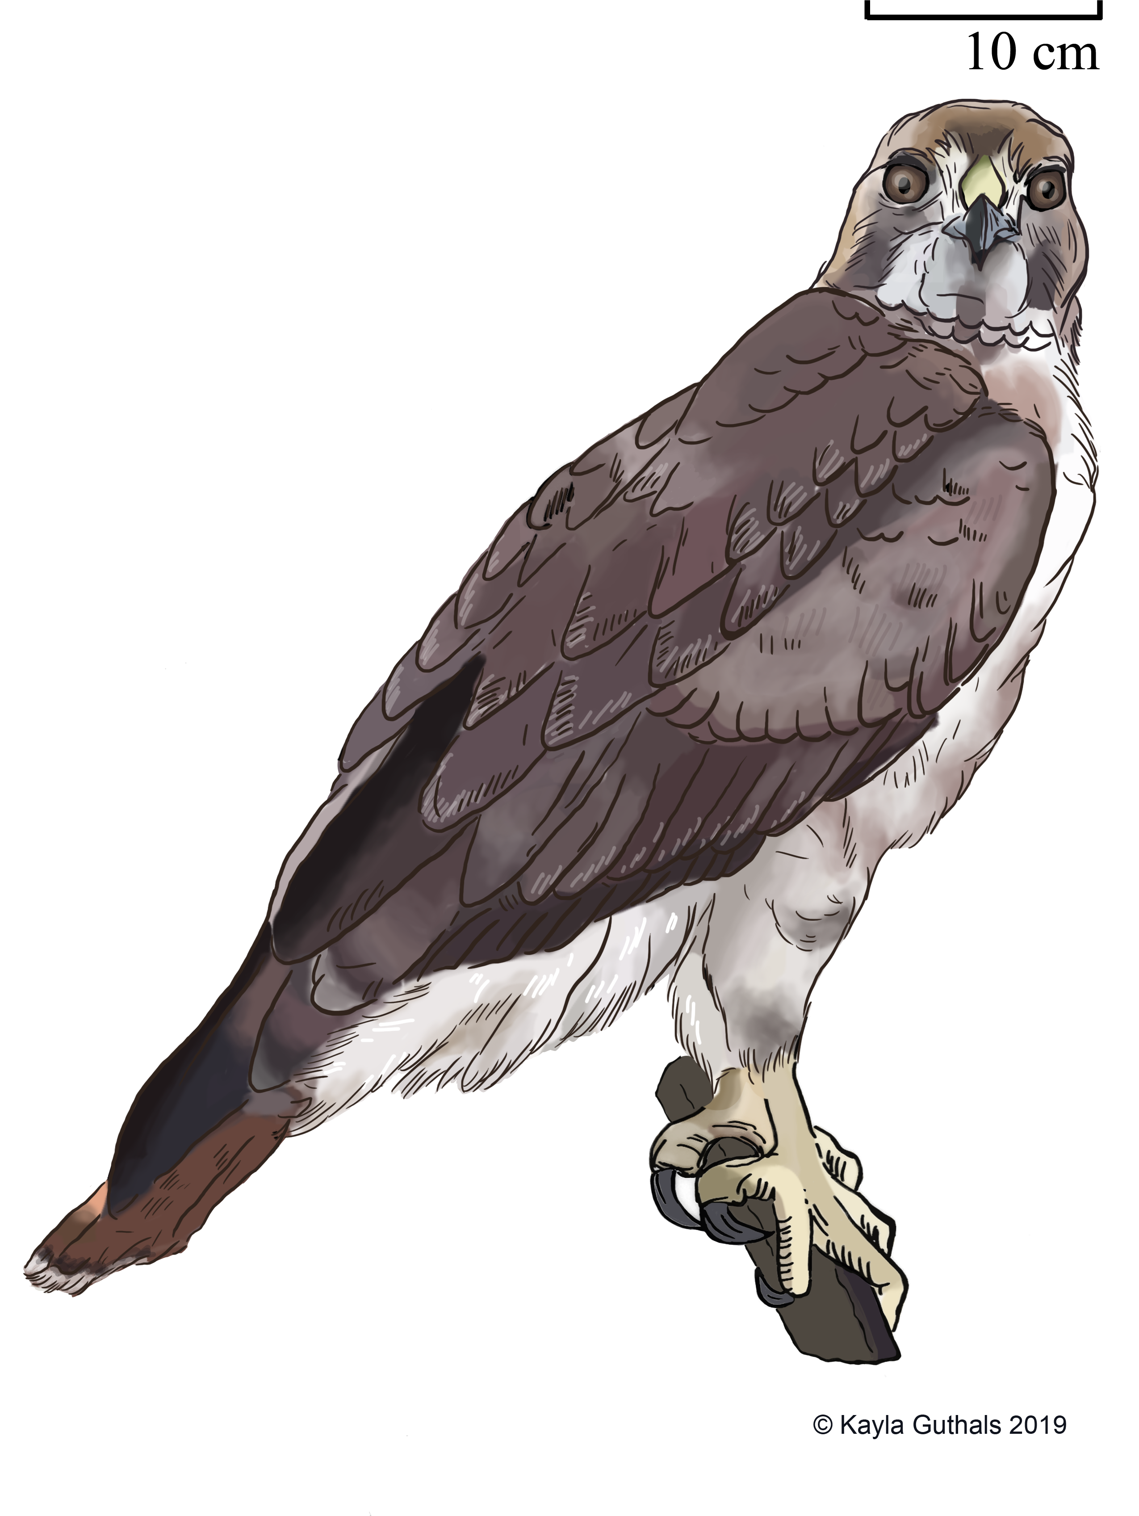

Slide 42
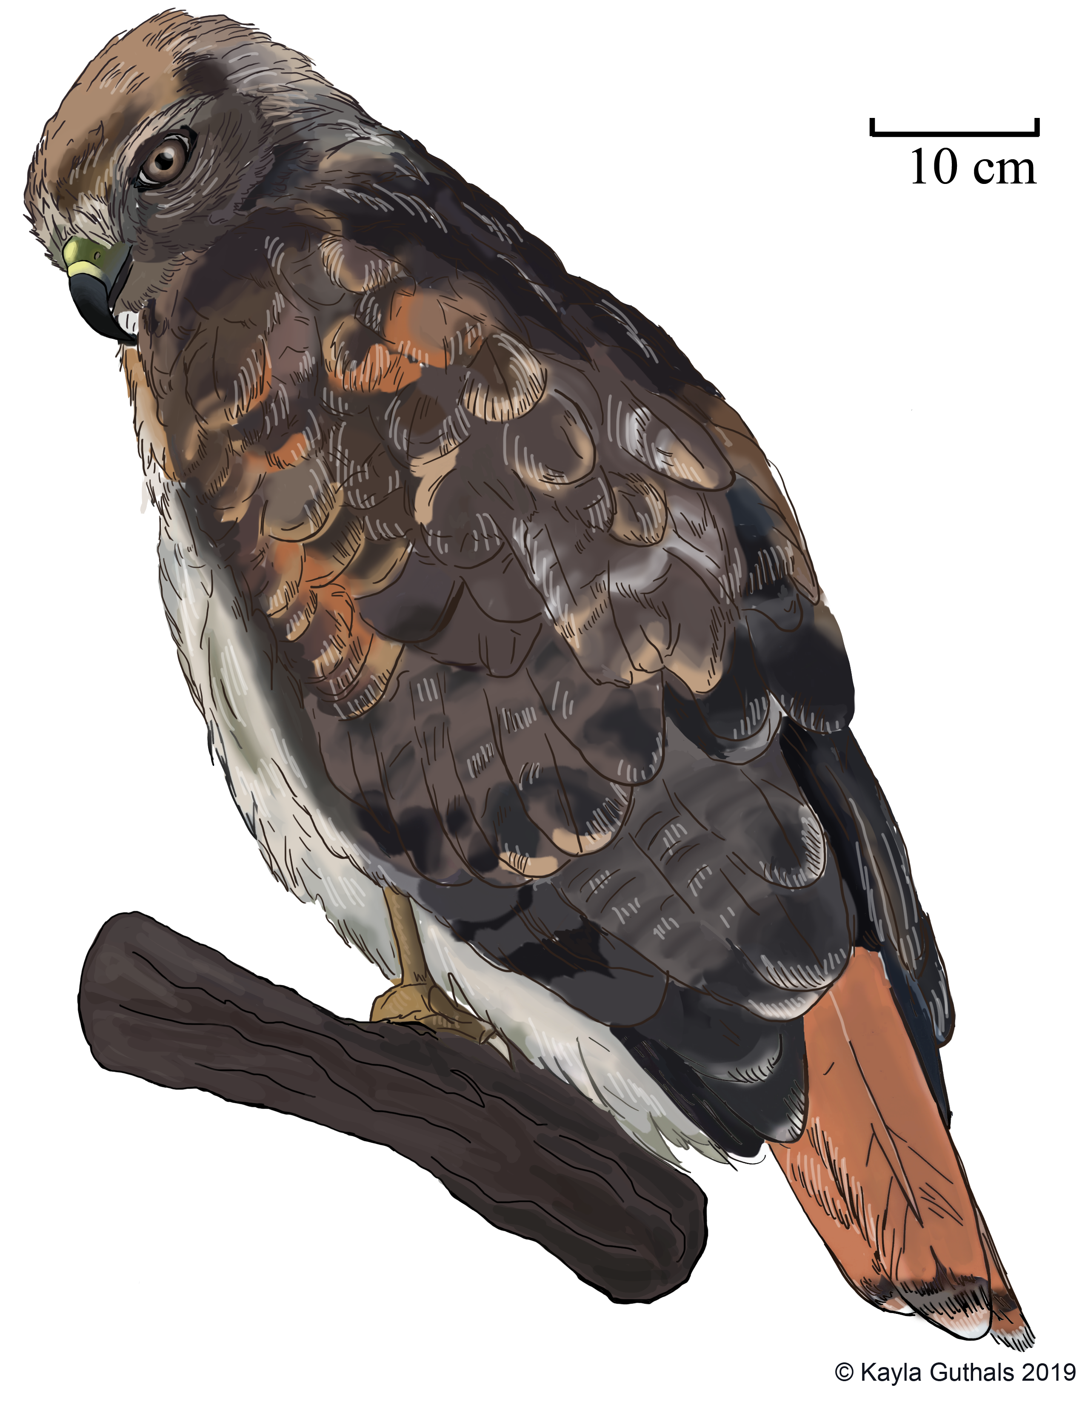

Slide 43
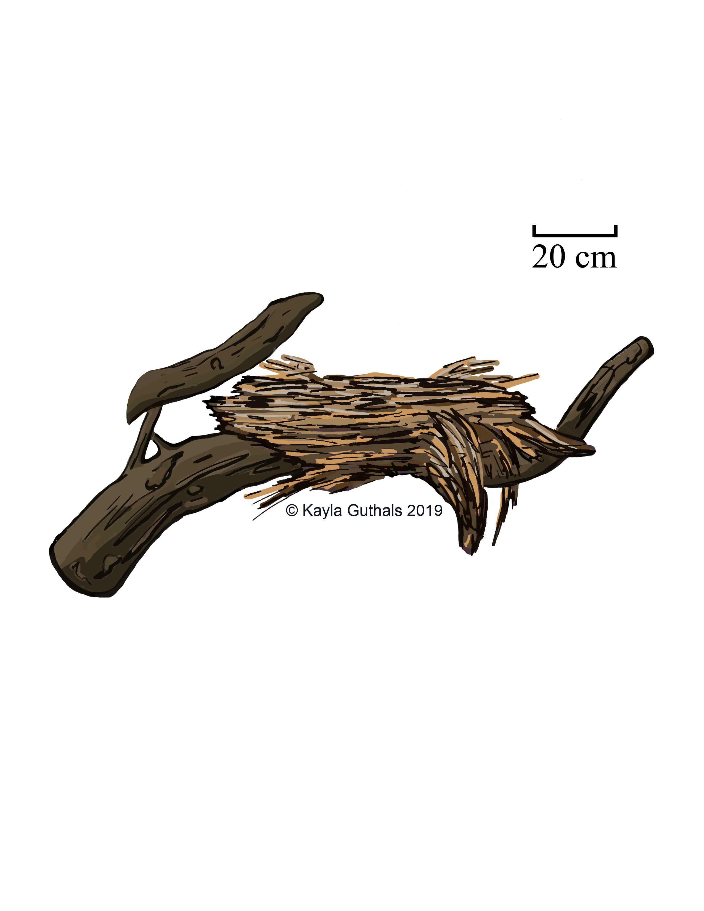

Slide 44
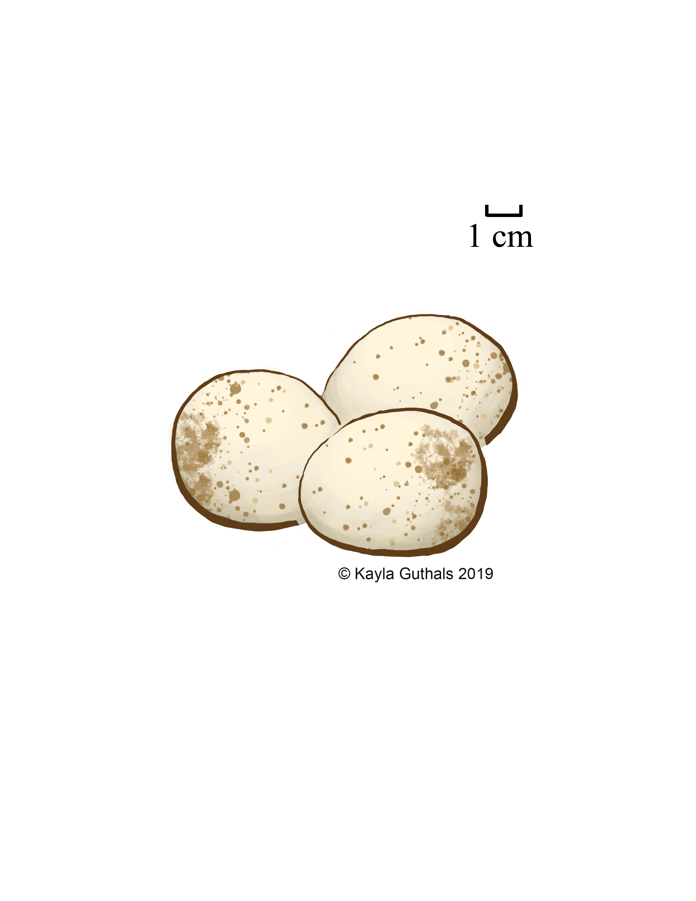

Slide 45
Buteo jamaicensis
Red-tailed Hawk
Female
Fun Fact: Red-tailed Hawks are carnivores, eating mostly mammals

Slide 46
Buteo jamaicensis
Red-tailed Hawk
Male
Fun Fact: In movies, the cry made by an eagle is actually the cry of a Red-tailed Hawk

Slide 47
Buteo jamaicensis
Red-tailed Hawk
Eggs
Fun Fact: Red-tailed Hawks mate for life, and court each other with fancy flying

Slide 48
Buteo jamaicensis
Red-tailed Hawk
Nest
Fun Fact: Red-tailed Hawks prefer to nest at the top of tall trees, where they can see the whole landscape

Slide 49
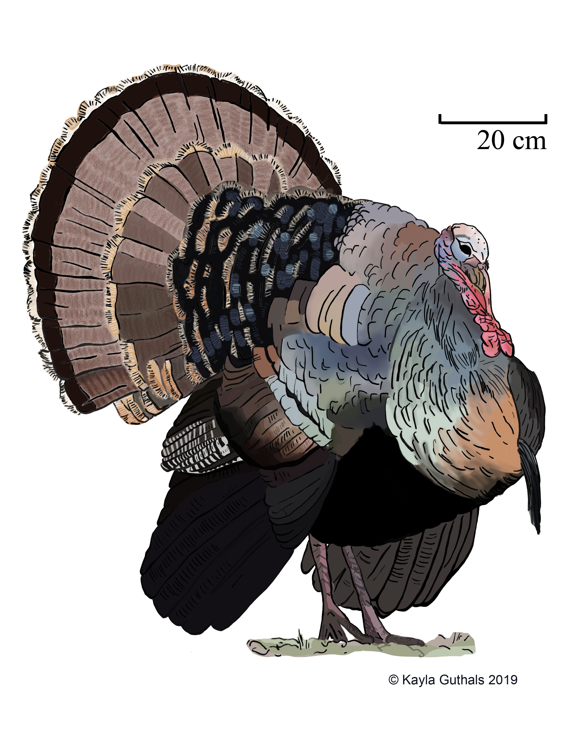

Slide 50
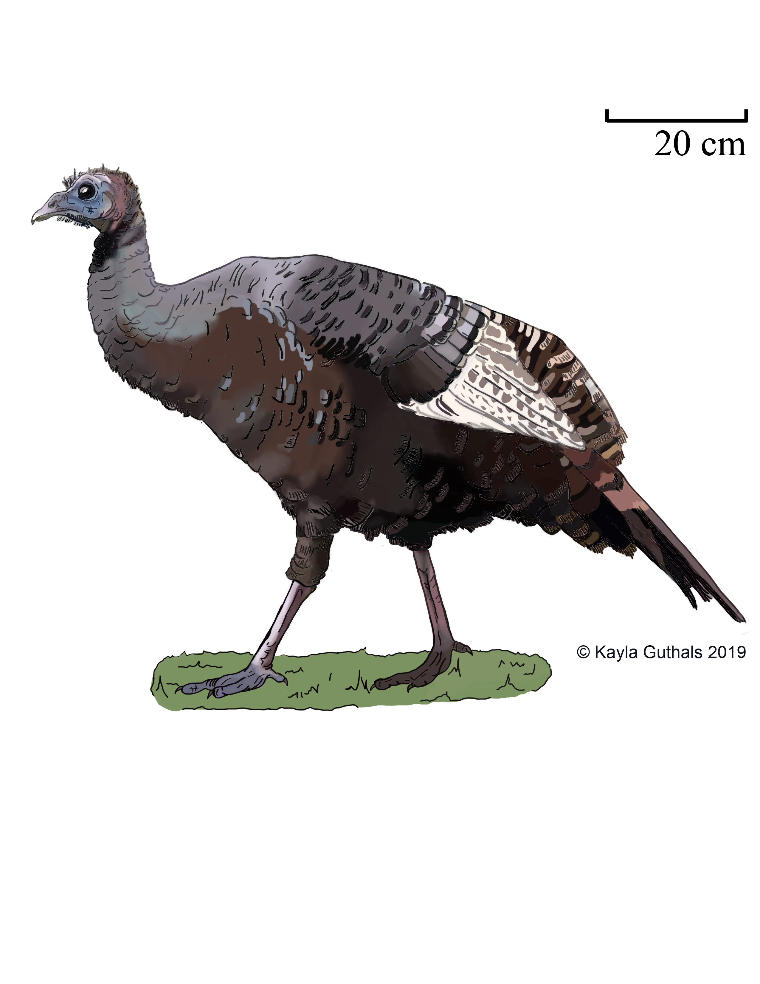

Slide 51
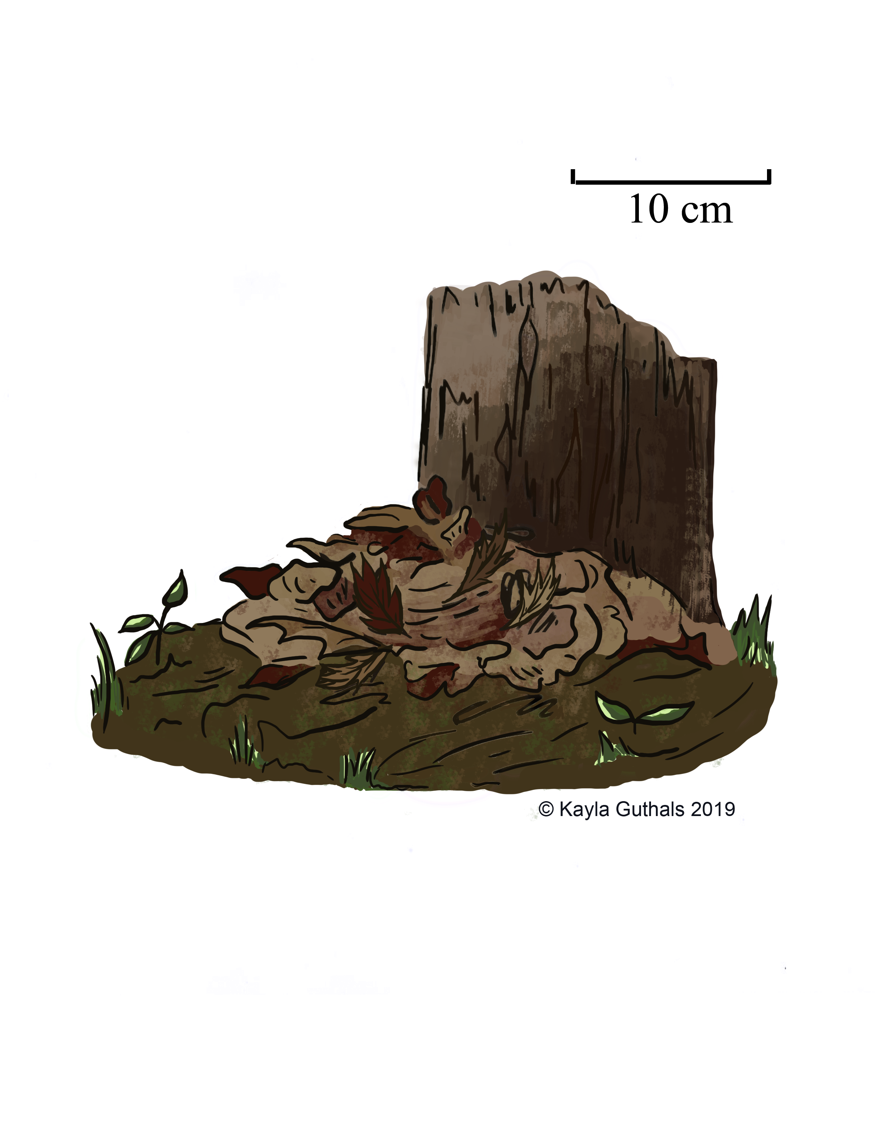

Slide 53
Meleagris gallopavo
Wild Turkey
Female
Fun Fact: Wild Turkeys eat mostly seeds, berries, and nuts, but they will sometimes eat small animals

Slide 54
Meleagris gallopavo
Wild Turkey
Male
Fun Fact: The fleshy parts of a turkey’s head are called “carbuncles” and they’re larger in males than females

Slide 55
Meleagris gallopavo
Wild Turkey
Eggs
Fun Fact: Outside of the breeding season males live in all-male flocks, while females raise their babies alone

Slide 56
Meleagris gallopavo
Wild Turkey
Nest
Fun Fact: The biggest predators of Wild Turkeys are human beings

Slide 57
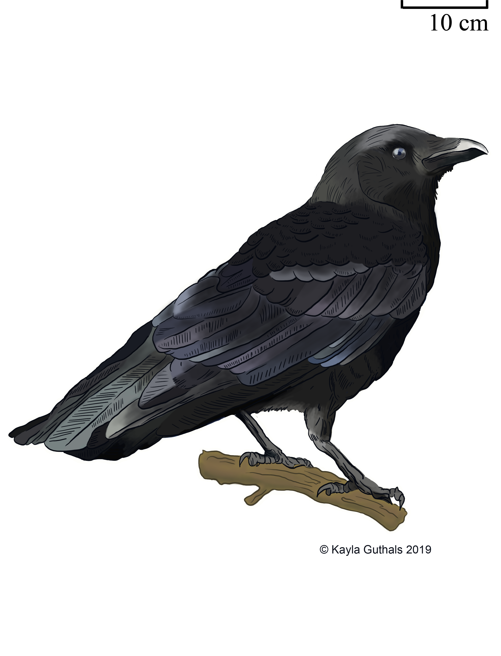

Slide 58
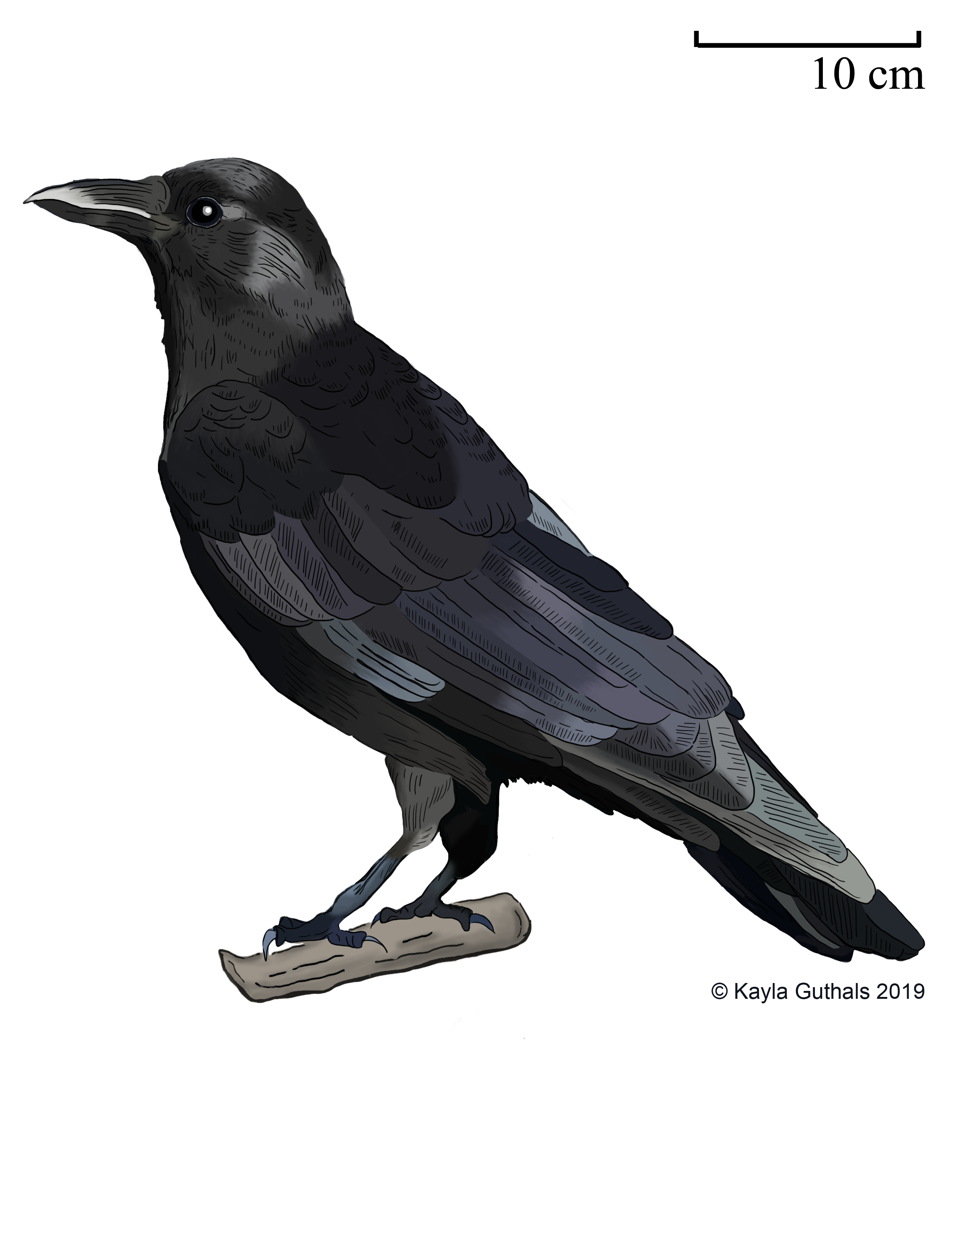

Slide 59
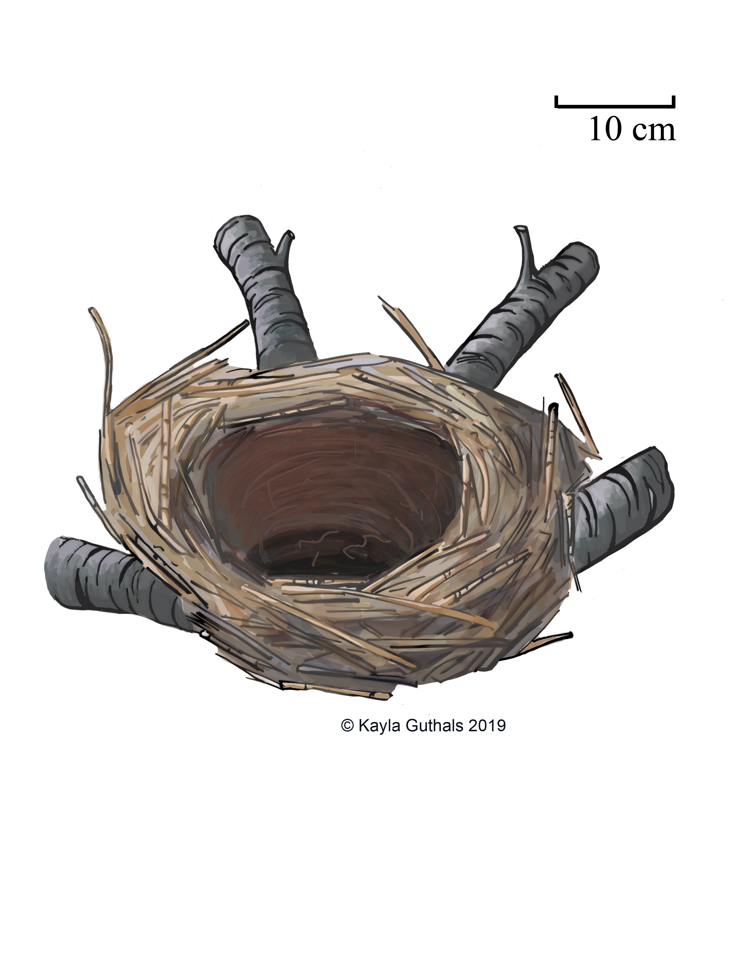

Slide 60
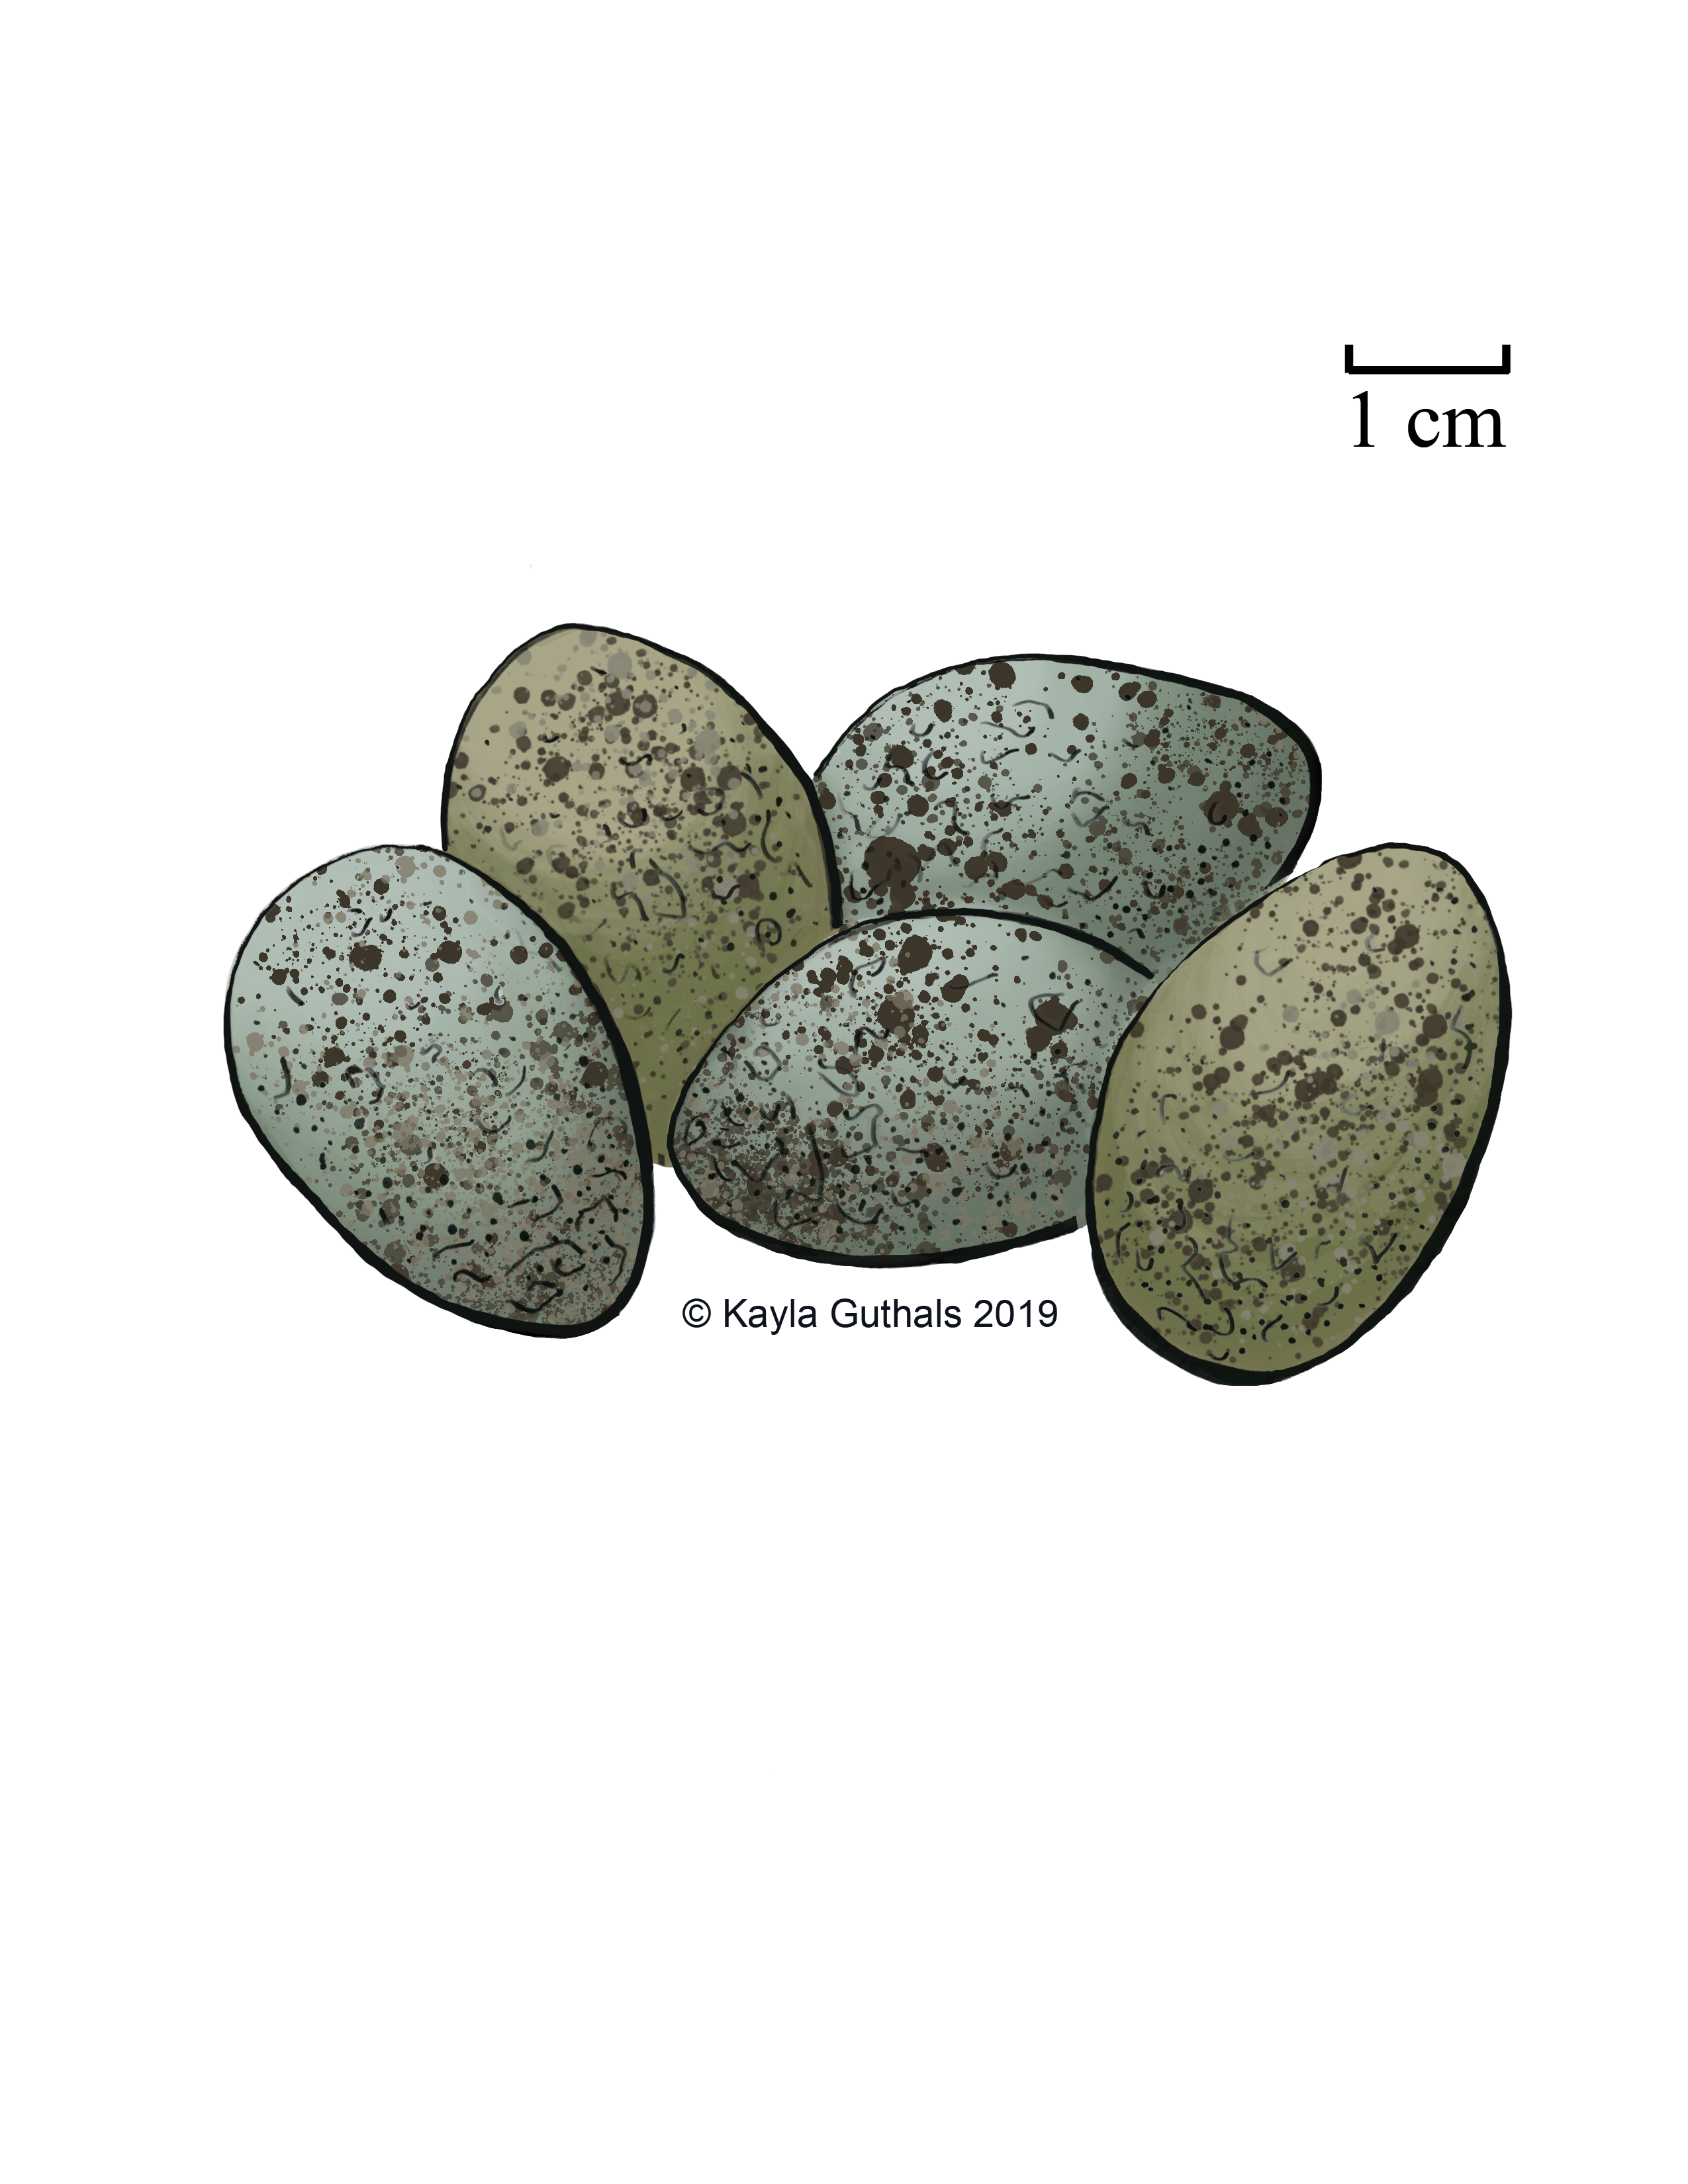

Slide 61
Corvus brachyrhynchos
American Crow
Female
Fun Fact: Crows can hold grudges, and will tell other crows if a certain person treated them poorly

Slide 62
Corvus brachyrhynchos
American Crow
Male
Fun Fact: Crows will eat almost anything, including worms, insects, fruit, and garbage

Slide 63
Corvus brachyrhynchos
American Crow
Eggs
Fun Fact: Young crows will often stay to help their parents build the nest and feed the chicks next year

Slide 64
Corvus brachyrhynchos
American Crow
Nest
Fun Fact: In the winter, crows sleep in roosts of up to 2 million birds

Slide 65
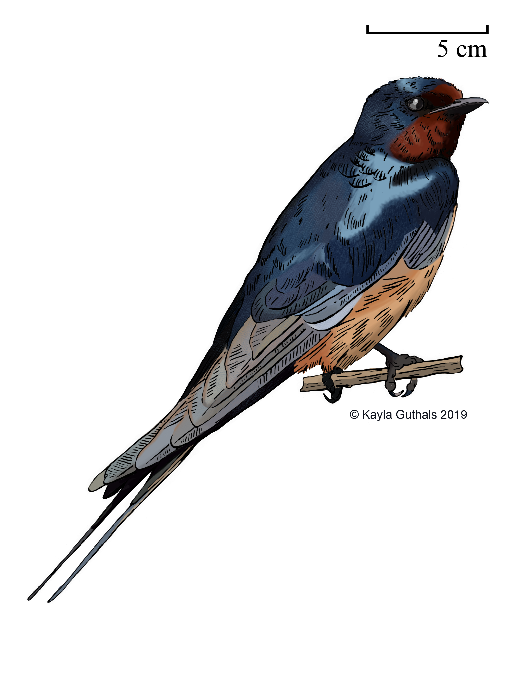

Slide 66
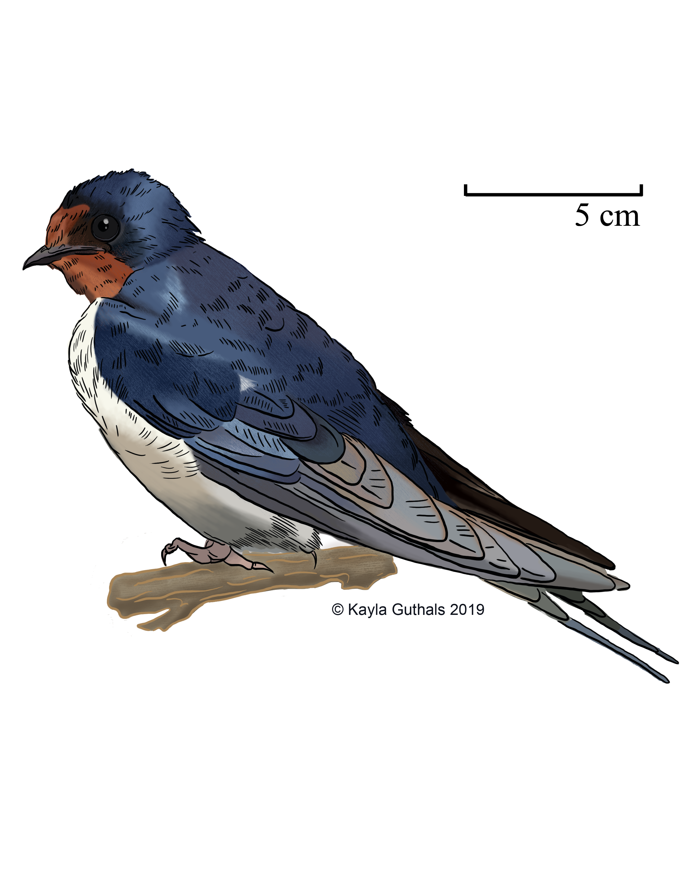

Slide 67
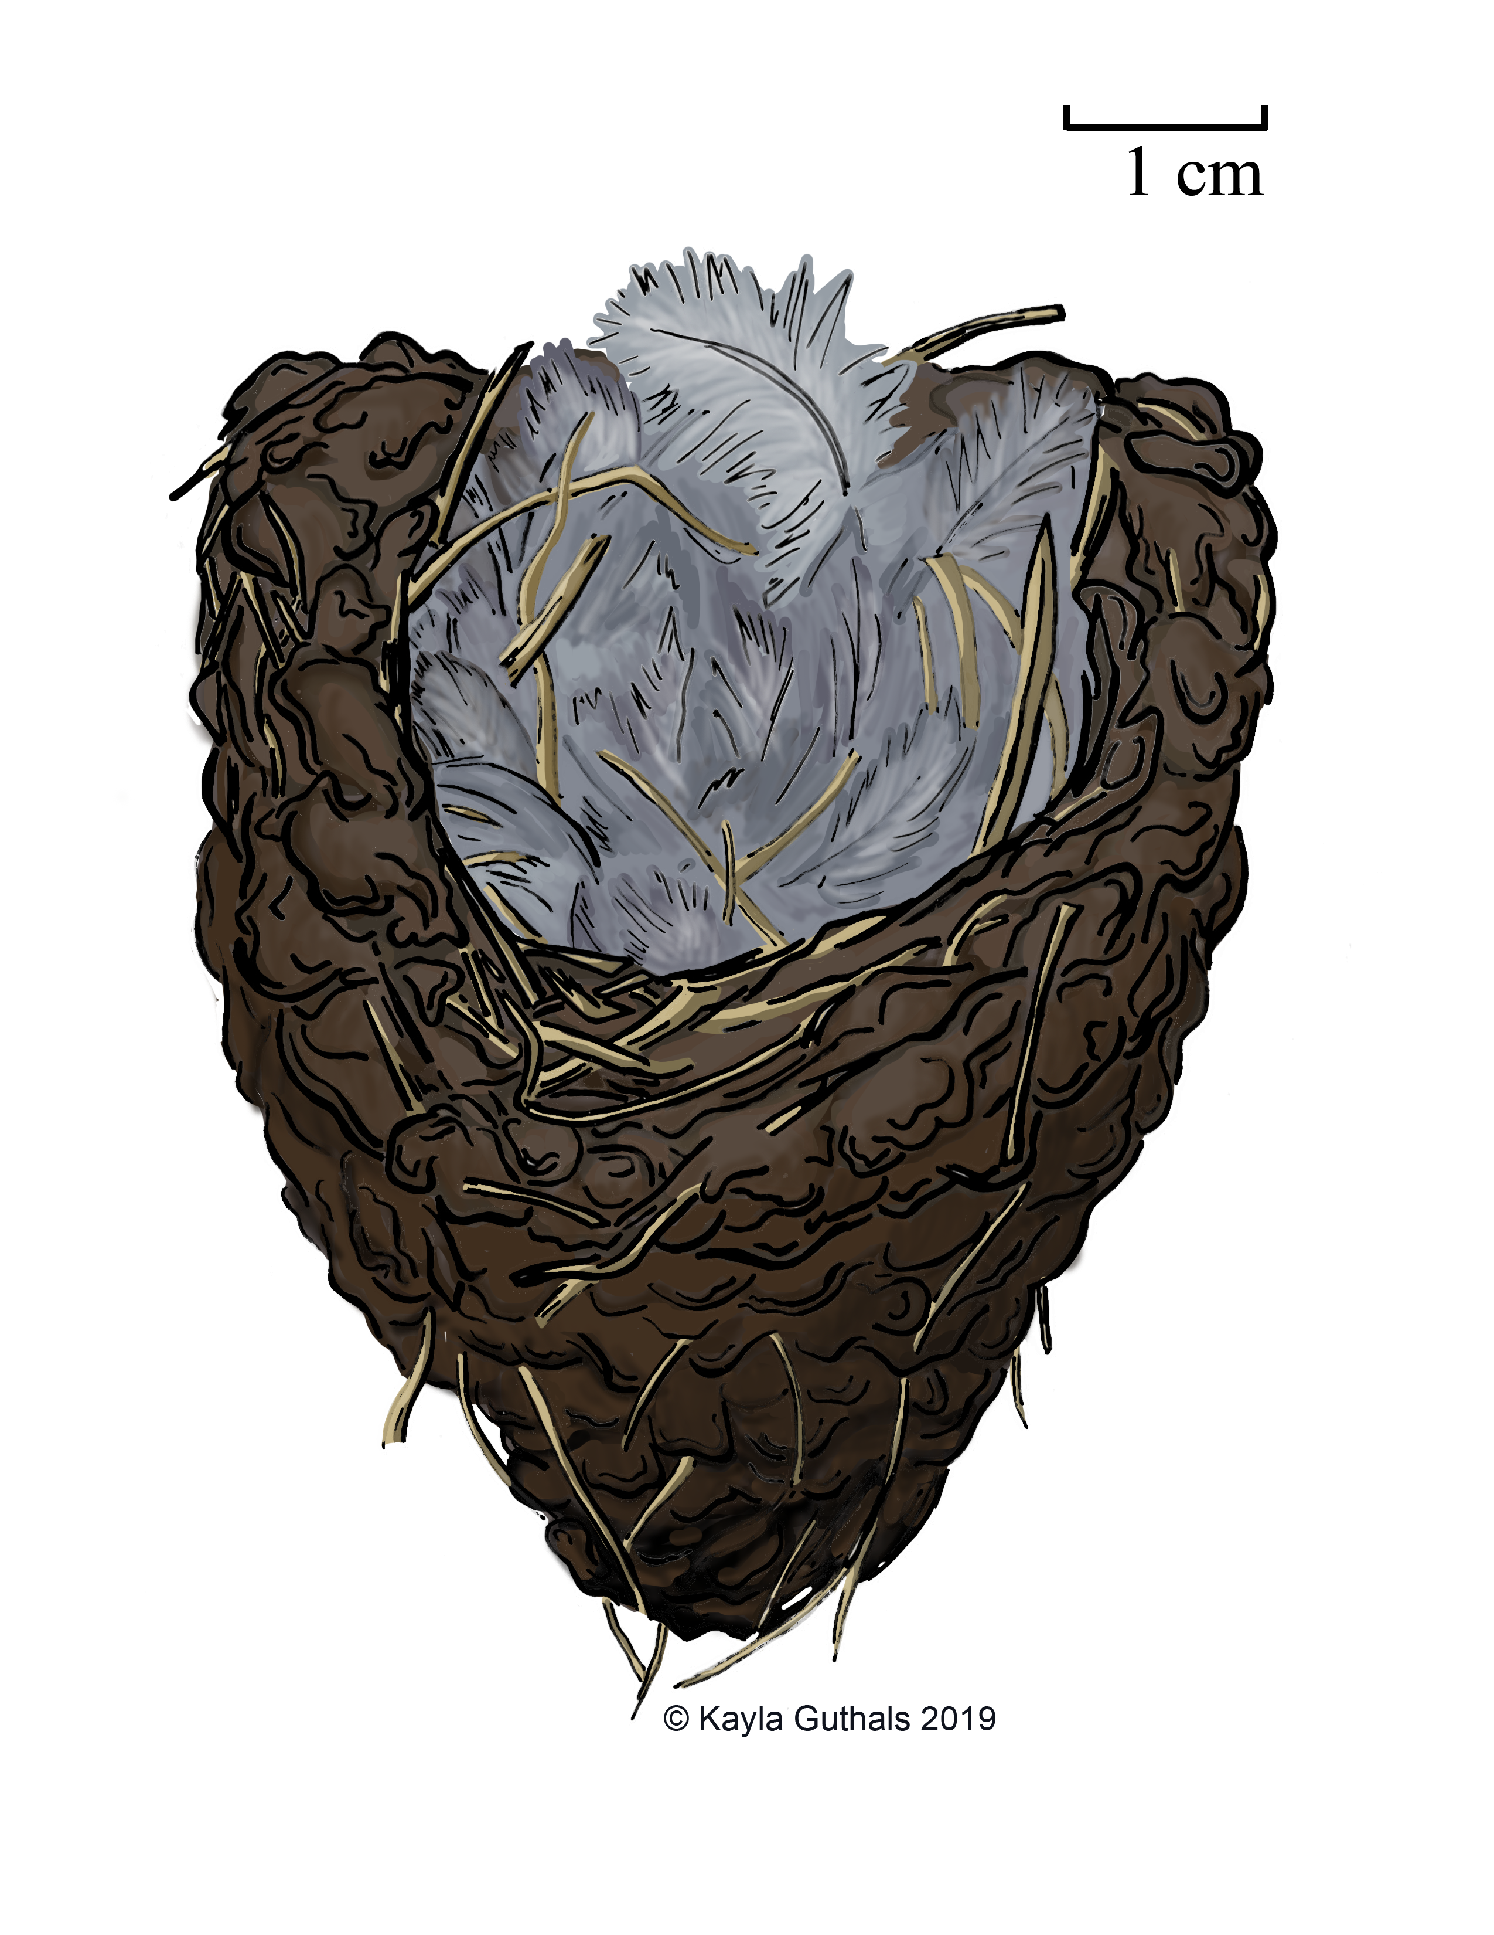

Slide 68
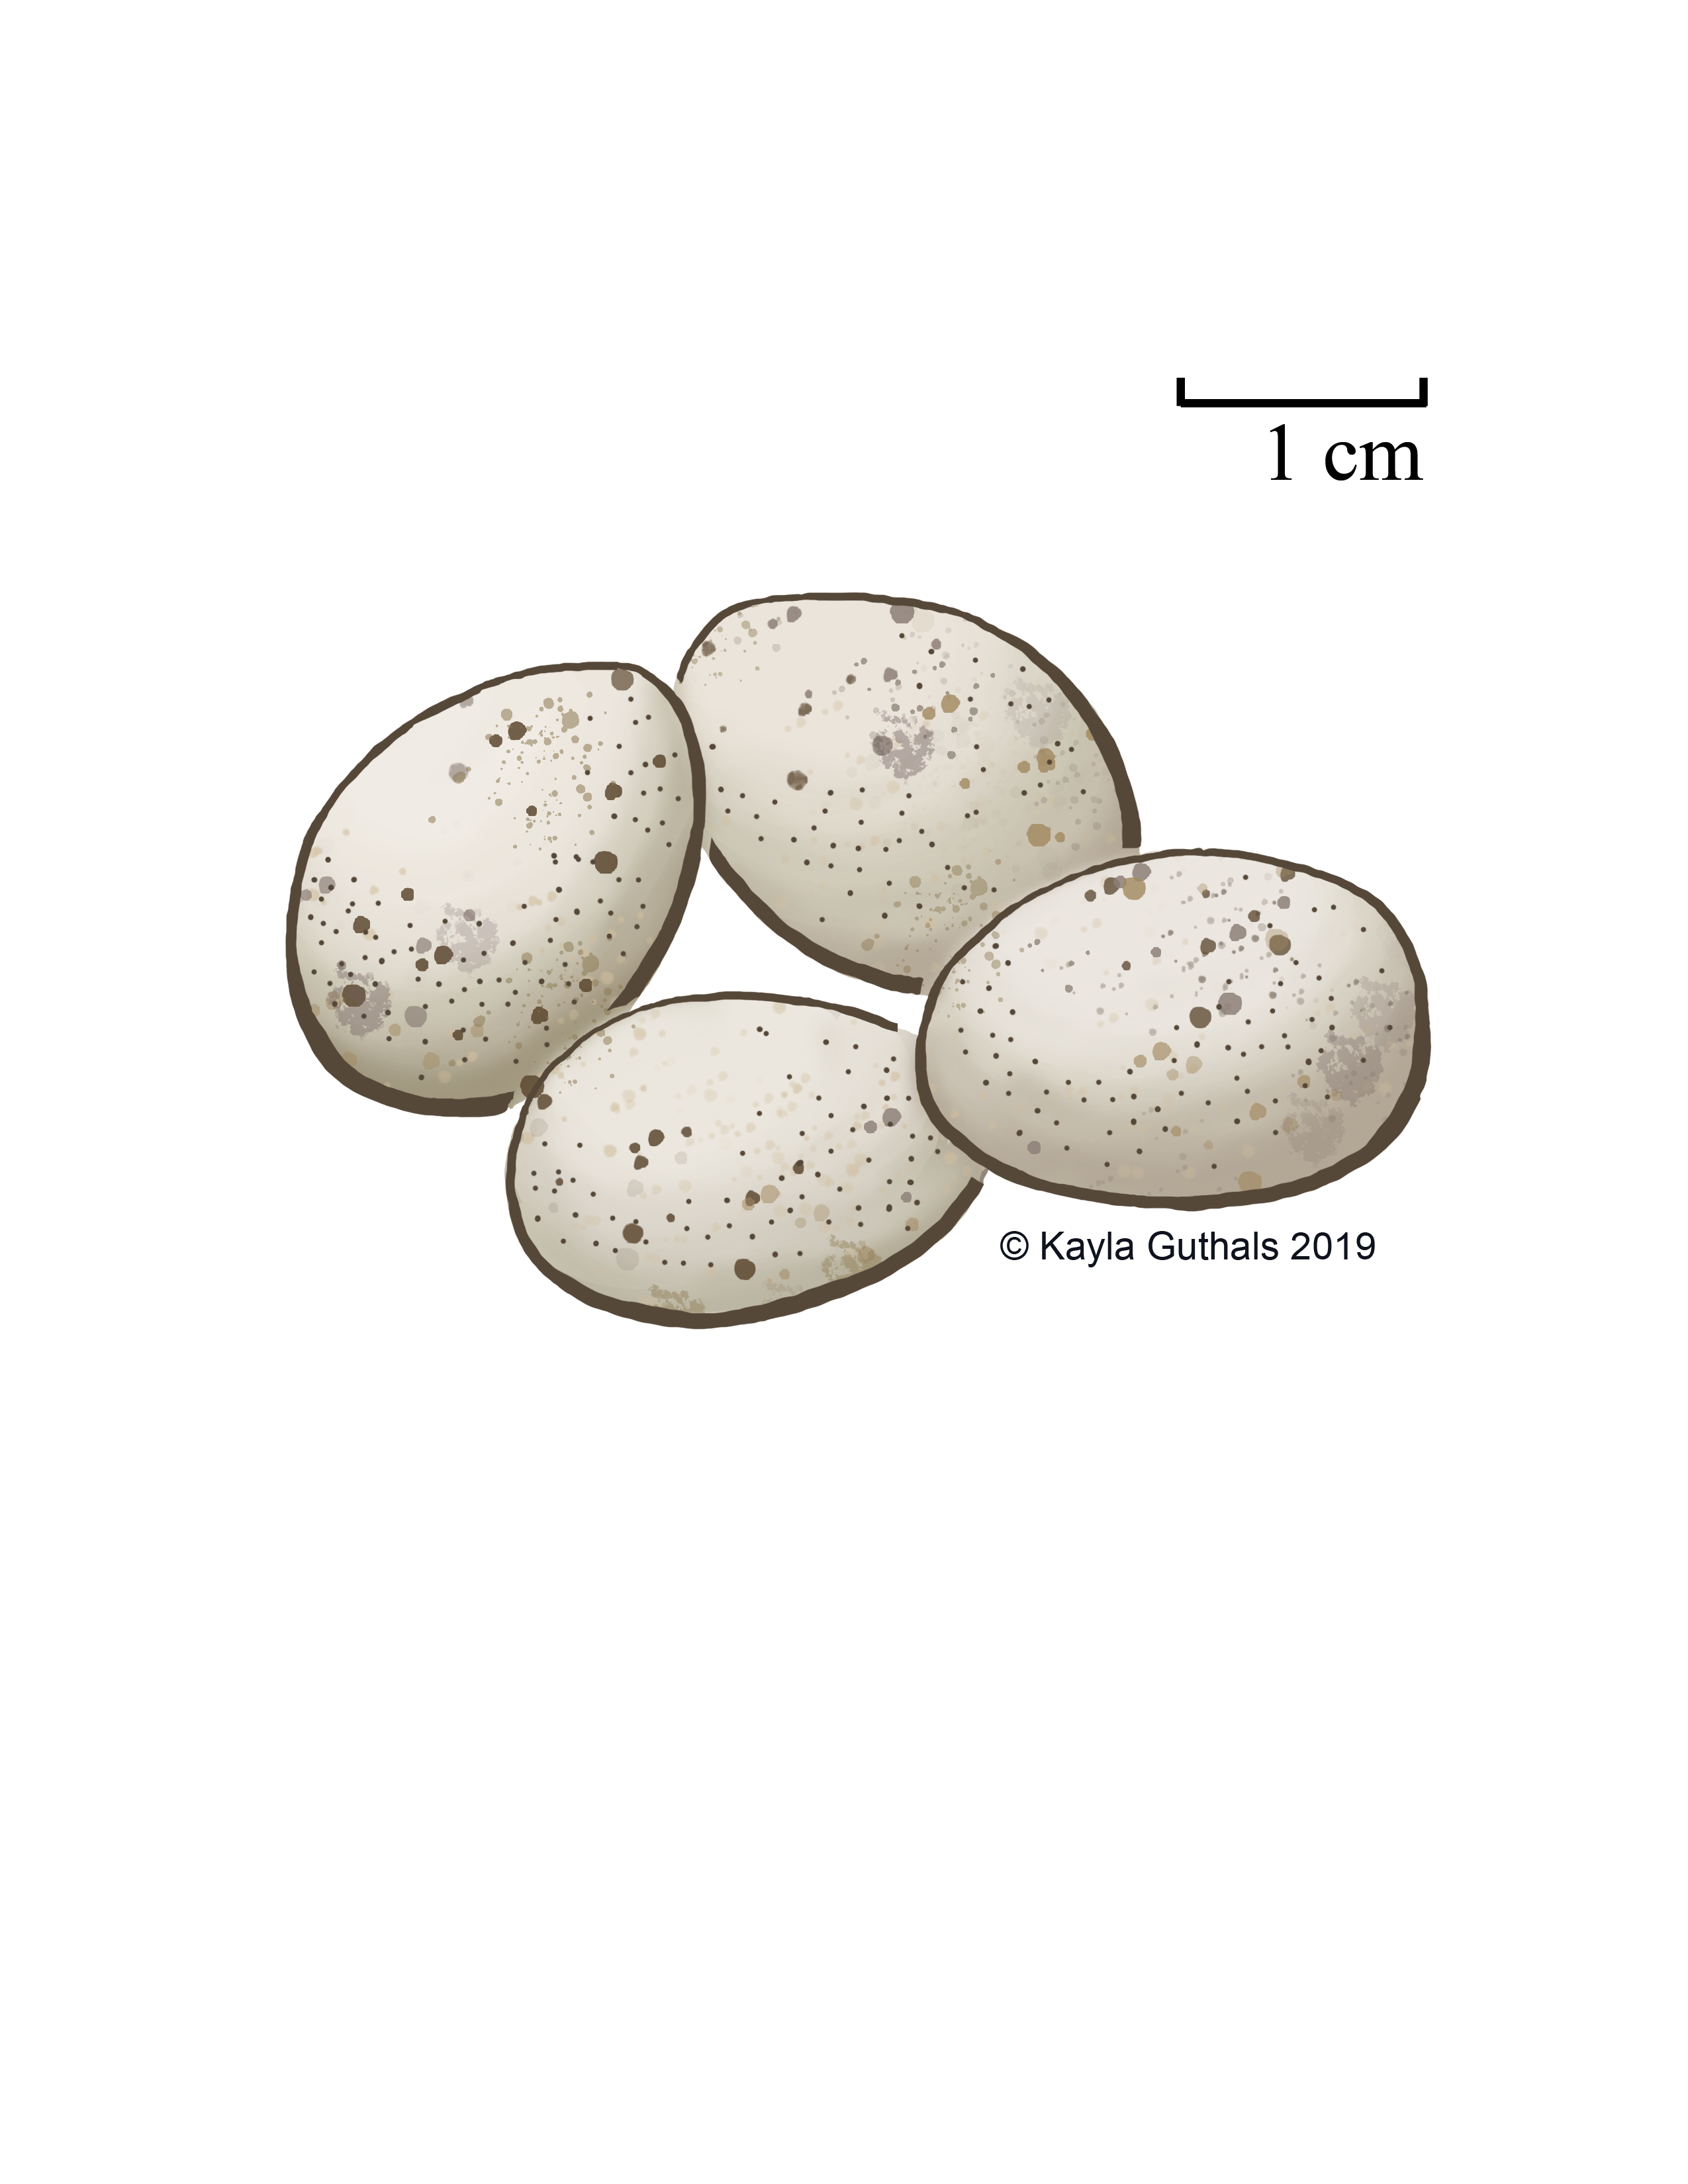

Slide 69
Hirundo rustica
Barn Swallow
Female
Fun Fact: Barn Swallows can feed, drink, and bathe while flying

Slide 70
Hirundo rustica
Barn Swallow
Male
Fun Fact: Since they’re so common and often live so close to humans, Barn Swallows are one of the most well-studies type of birds

Slide 71
Hirundo rustica
Barn Swallow
Eggs
Fun Fact: Barn swallow nests are considered signs of good luck in some places

Slide 72
Hirundo rustica
Barn Swallow
Nest
Fun Fact: Barn Swallows originally built their nests in caves, but now almost always build them on buildings

Slide 73
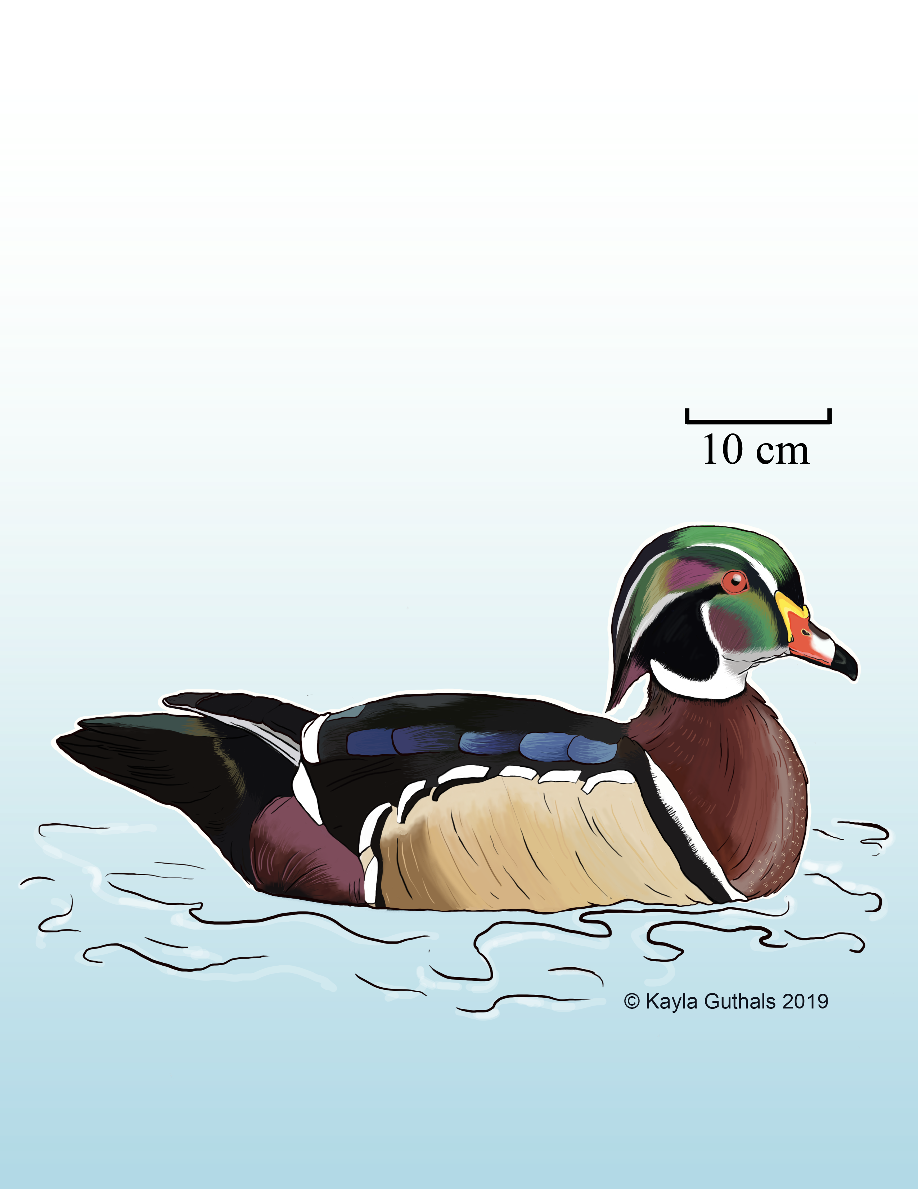

Slide 74
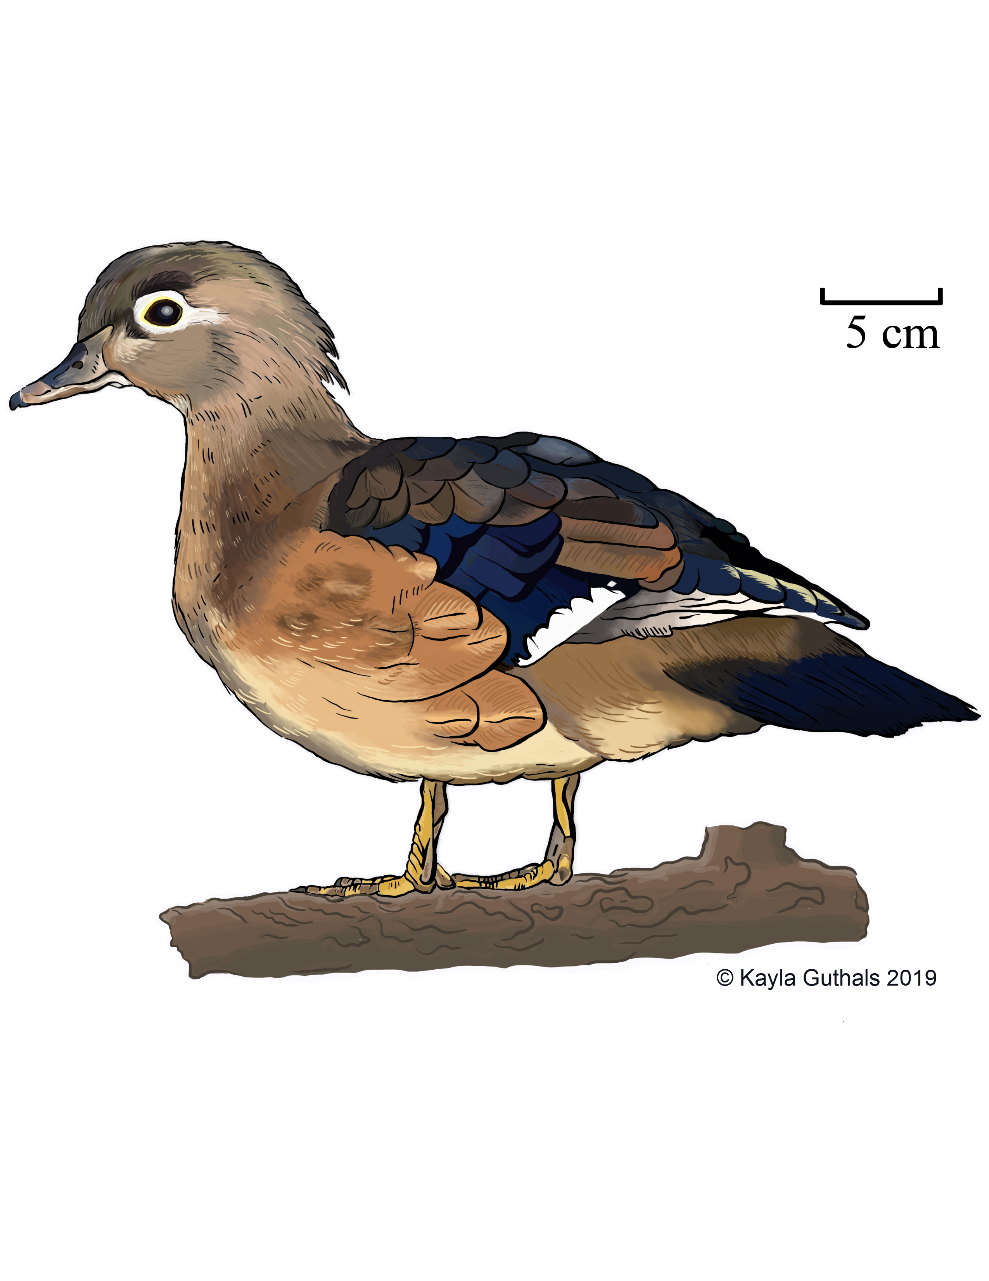

Slide 76
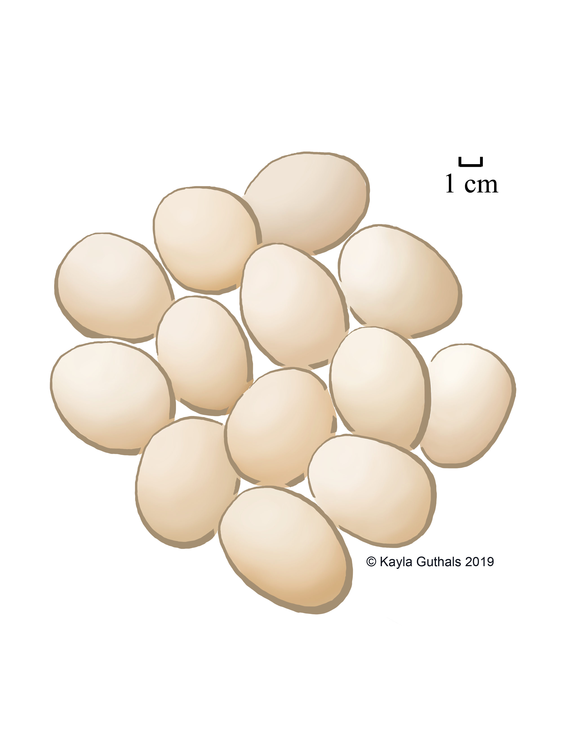

Slide 77
Aix sponsa
Wood Duck
Female
Fun Fact: When a predator is nearby, a female Wood Duck may fake a broken wing to lure it away from her ducklings

Slide 78
Aix sponsa
Wood Duck
Male
Fun Fact: Wood Ducks feed by taking short, shallow dives, called “dabbling”

Slide 79
Aix sponsa
Wood Duck
Eggs
Fun Fact: Female Wood Ducks often lay eggs in other females’ nests, and leave them to be raised by the other female

Slide 80
Aix sponsa
Wood Duck
Nest
Fun Fact: Many wood ducks nest in “nest boxes” set up for them by humans, especially where natural tree holes are rare

Slide 81
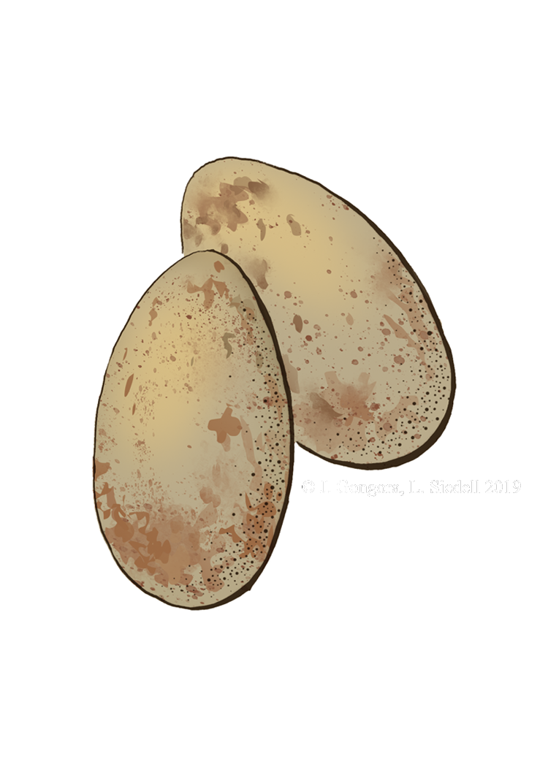
Egghead
Human(ities) Games 2019

Slide 86
Game Designer
Amy Chen
Project Team
Trina Roberts
Liz Crooks
Cody Crawford
Art
Jordan Gongora
Libby Siedell
Kayla Guthals
Human(ities) Games 2019

